Slide 1
Inspection and identification systems enabling the reuse and recycling of EoL composite materials
19th Feb 2025 (online)
Miguel Gómez – AIMEN
Camilo Prieto - AIMEN

Slide 2
Content overview
AIMEN Technology Centre
EURECOMP Project introduction
Inspection Technologies
Identification Technologies
Conclusions
Active Thermography
Ultrasound Testing
Hyperspectral Imaging
Laser Induced Spectroscopy Analysis (LIBS)
Raman Spectroscopy
5th webinar | 19-02-2025 | online

Slide 3
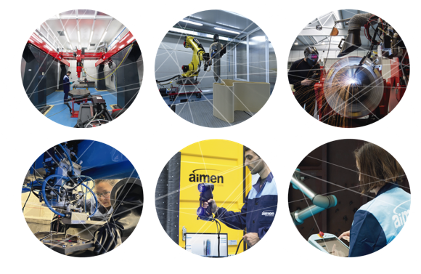
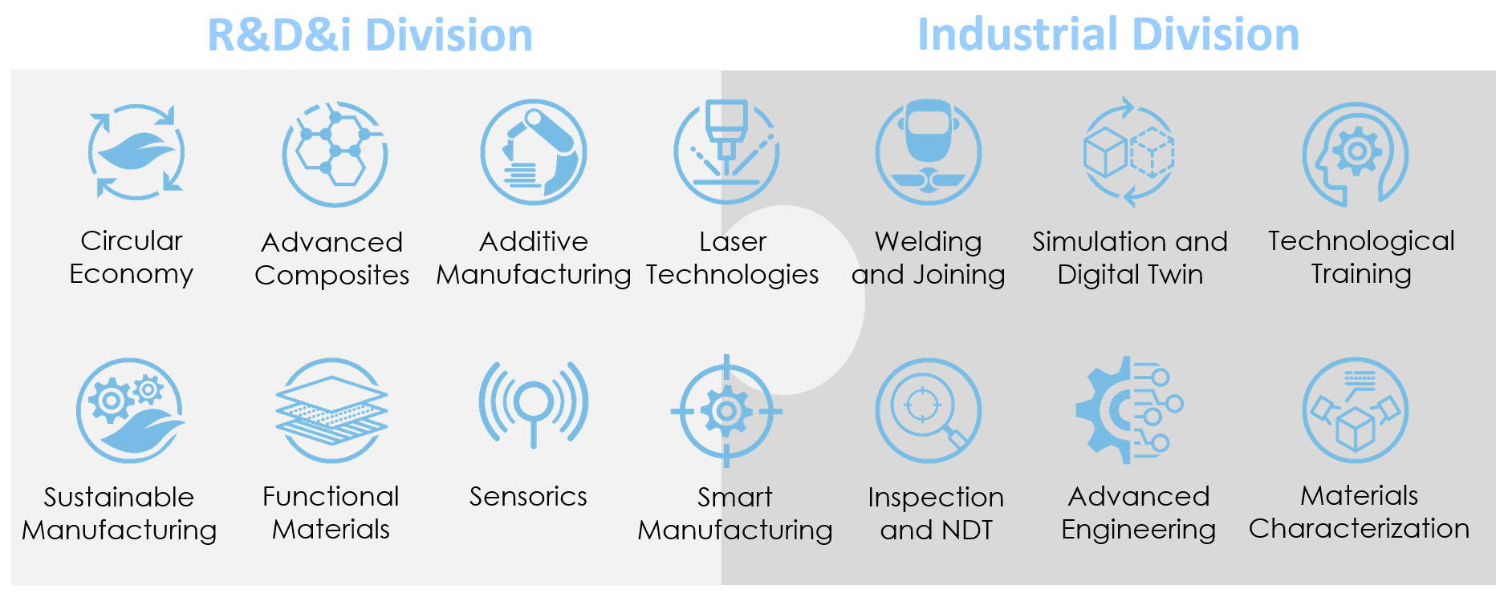
AIMEN Technology Centre
Innovation and Technology Centre that develops
R&D&i activities and provides technological services to the industry in the fields of:
MATERIALS, ADVANCED MANUFACTURING PROCESSES, DIGITIZATION and SUSTAINABILITY.
Non-profit private association: 300+ employees
9500m² of scientific-technological infrastructures
55+ years of experience (since 1967)
250+ R&D&i projects in last 10years
50 R&D projects per year
5th webinar | 19-02-2025 | online

Slide 4
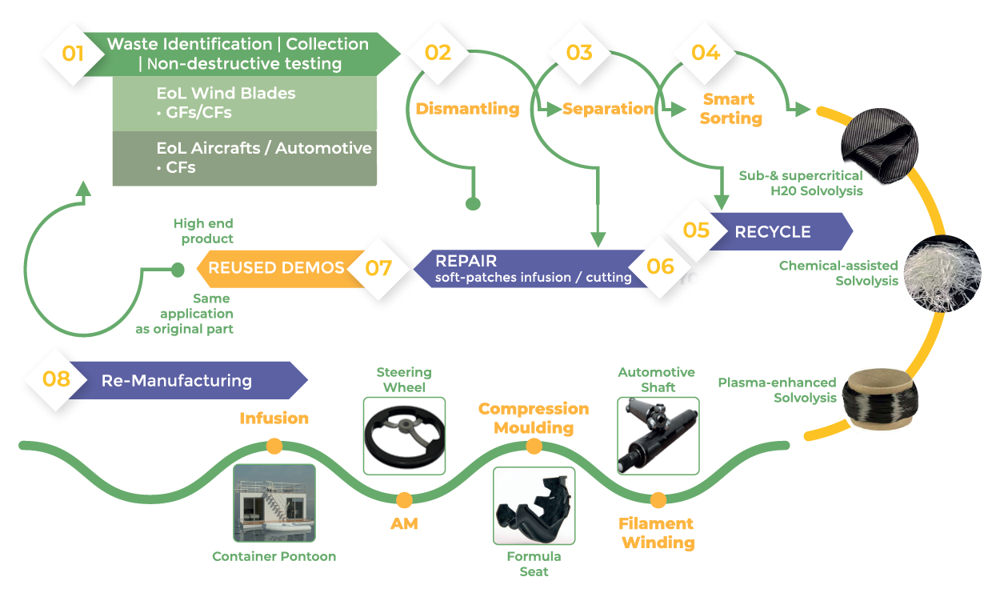
Introduction: EURECOMP project
EU project with a strong focus on circularity, set out to provide sustainable methods towards repair, recycling and reuse of end-of-life composite materials
https://eurecomp.eu

Slide 5
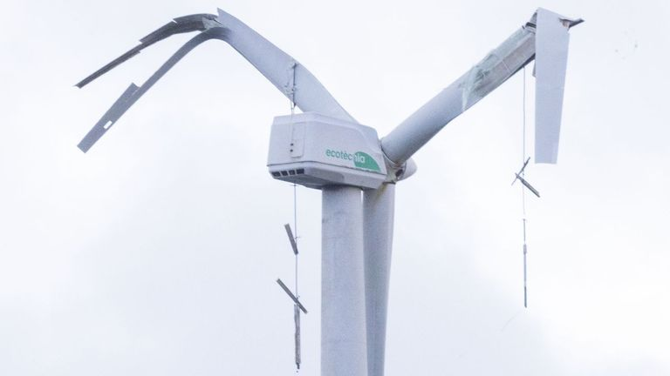
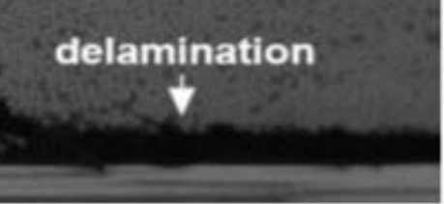
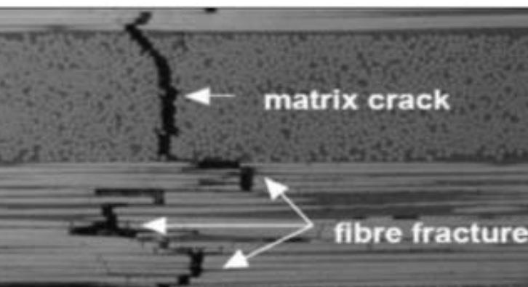
Inspection technologies
Failure analysis of wind turbine blades and aircraft composite structures is critical for assessing potential reuse in other applications.
Identifying the root causes of damage enables evaluation of structural integrity and determination of suitable secondary uses.
This promotes safety, sustainability, and waste reduction by extending the lifecycle of composite materials.
COMMON DEFECTS
Delamination:
Layers of the matrix and fiber of the composite are separated.
Blisters:
Are small air pockets
Inclusions of foreign material
Cracks:
Fissures, fractures and breaks
5th webinar | 19-02-2025 | online

Slide 6
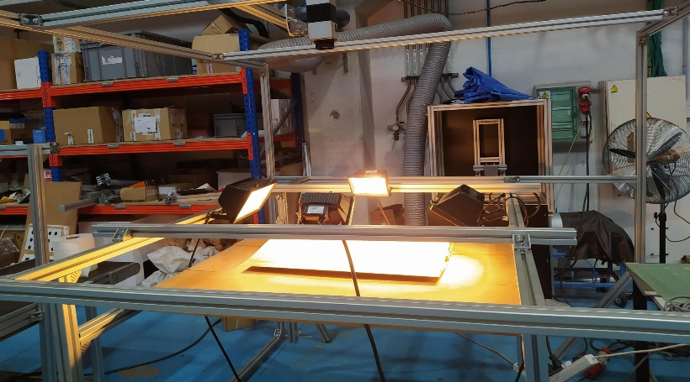
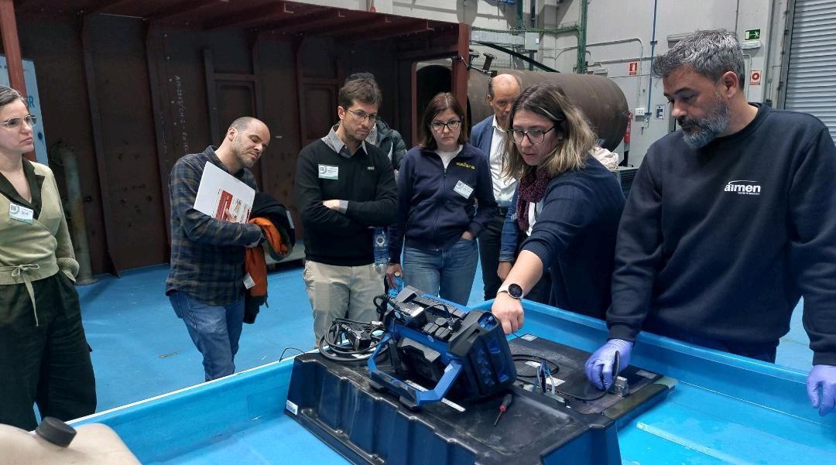
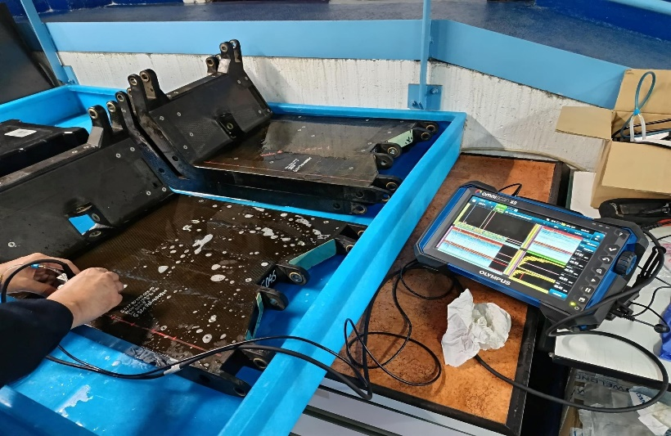
Non-Destructive Testing (NDT)
A group of methods used to evaluate the integrity, properties, or defects of materials or components without causing damage, using techniques like ultrasonic testing, radiography, and thermography, ensuring safety, quality, and reliability across industries.
THERMOGRAPHY
ULTRASOUND TESTING (UT)
5th webinar | 19-02-2025 | online

Slide 7
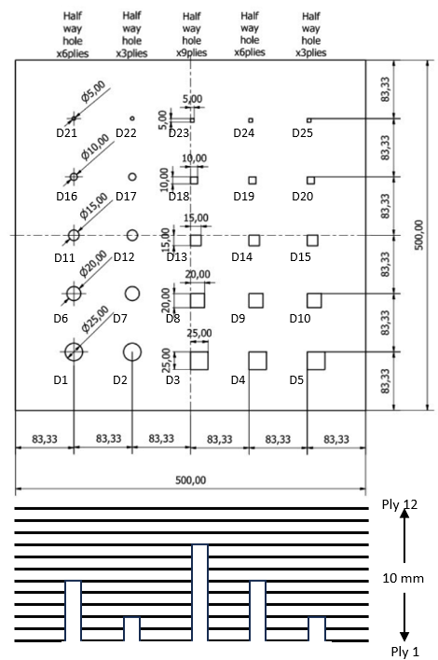
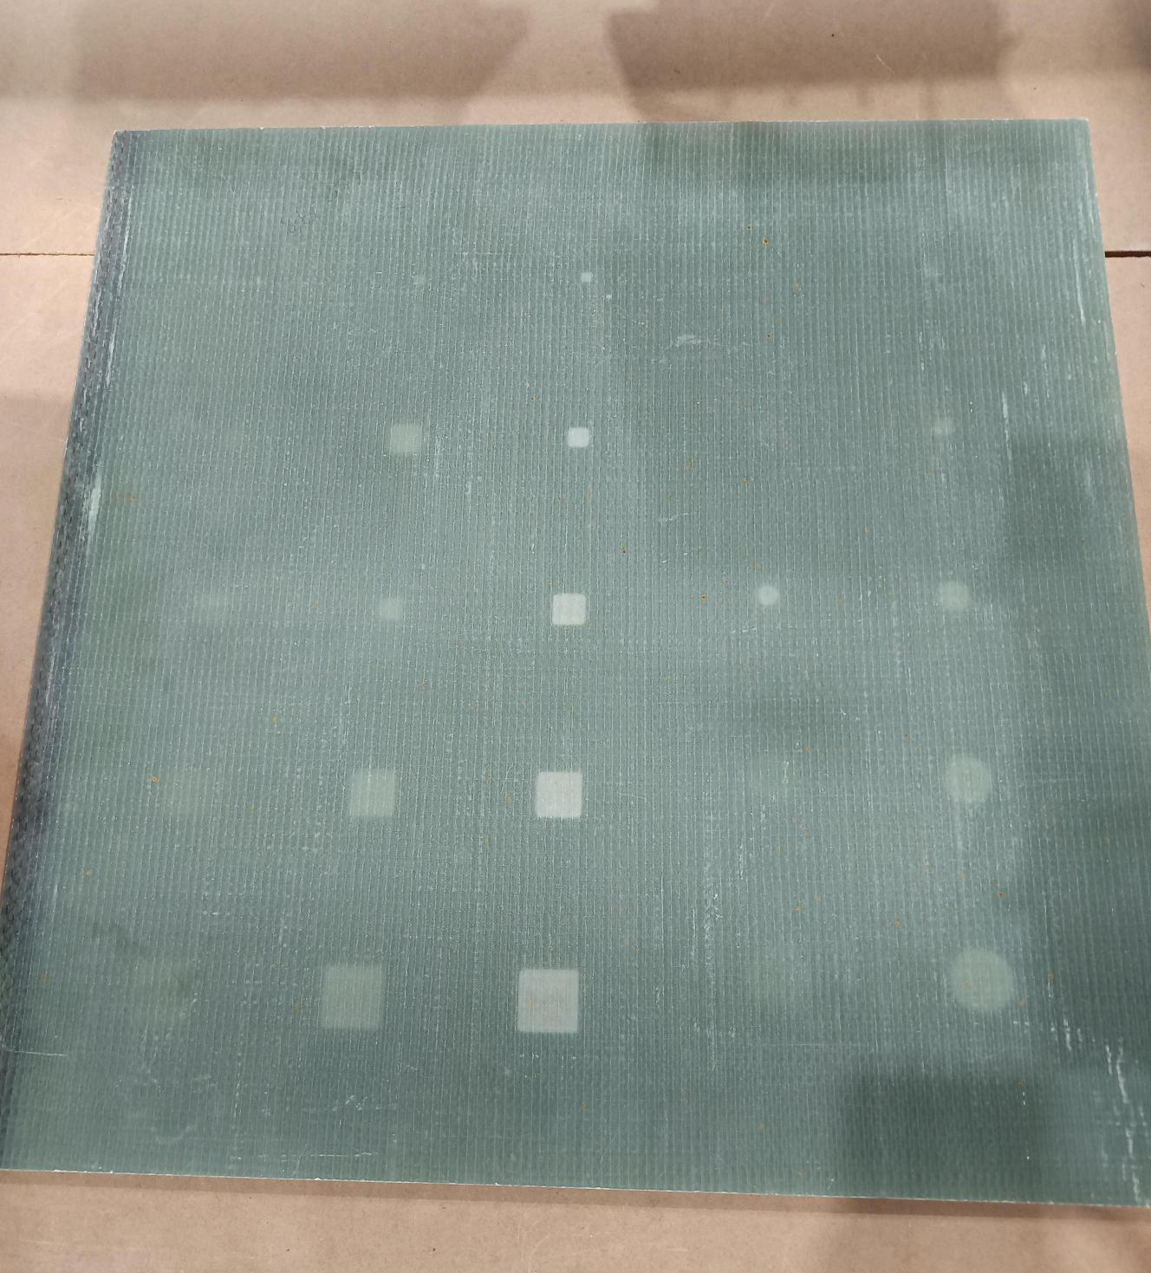
Test Specimen – case study
50 x 50 cm Glass Fiber Reinforced Polymer piece with artificial defects.
Description:
Made of 12 plies of glass-fiber filled with epoxy
Thickness of 10 mm
25 numbered half-way hole defects
Defects are found at three different depths:
2.5 mm
5 mm
7.5 mm
5th webinar | 19-02-2025 | online

Slide 8
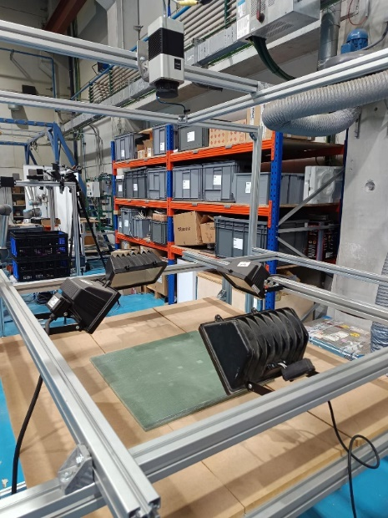
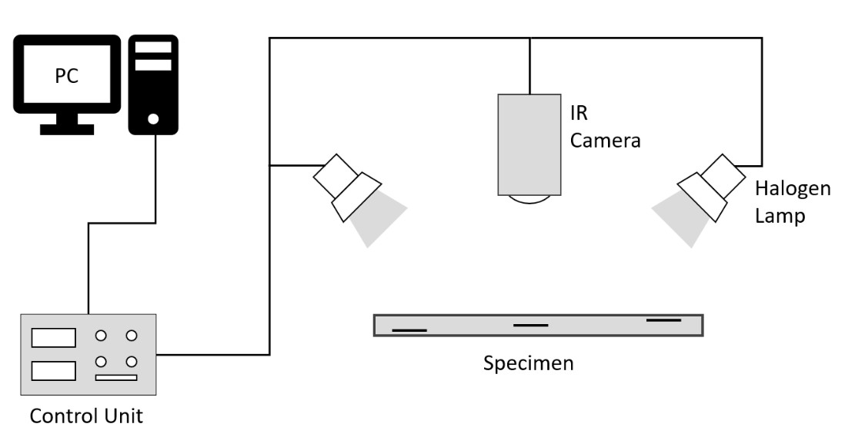
Active Thermography
It involves the use of a heat source to stimulate an object with a heat pulse. An infrared camera records a video of the object to measure the heating and cooling process on the object's surface.
FEATURES
High speed analysis
Provide two-dimensional thermal images
ISSUES
Non-uniform surface heating
Lateral heat difusion
Environmental noise
5th webinar | 19-02-2025 | online

Slide 9
Active Thermography: Postprocessing Methods
PULSED PHASE THERMOGRAPHY
Pulsed Phase Thermography
A thermal image sequence post-processing method that involves the calculation of the phase of a thermal image sequence using a Discrete Fourier Transform.
PRINCIPAL COMPONENT THERMOGRAPHY
A statistical technique used to identify specific patterns in large datasets containing a high number of features per observation and analyze them to enable the depicting of similarities and differences of specific patterns
Principal Components Thermography
5th webinar | 19-02-2025 | online

Slide 10
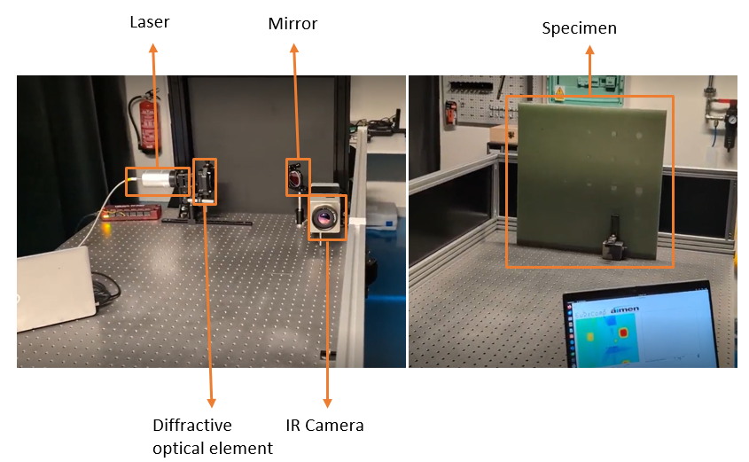
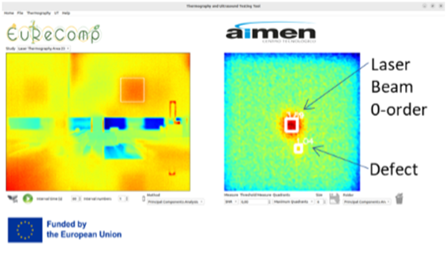
Laser Active Thermography
Laser
Mirror
Specimen
Difractive optical element (DOE)
IR camera
PC+SW acquisition and analysis
Advantages
Homogeneous illumination
Adjustable beam shape and size
Modulable warming curve
Selective analysis area
Allow scanning procedure
Issues (current setup)
Smaller inspection area
Laser Beam 0-order
5th webinar | 19-02-2025 | online

Slide 11
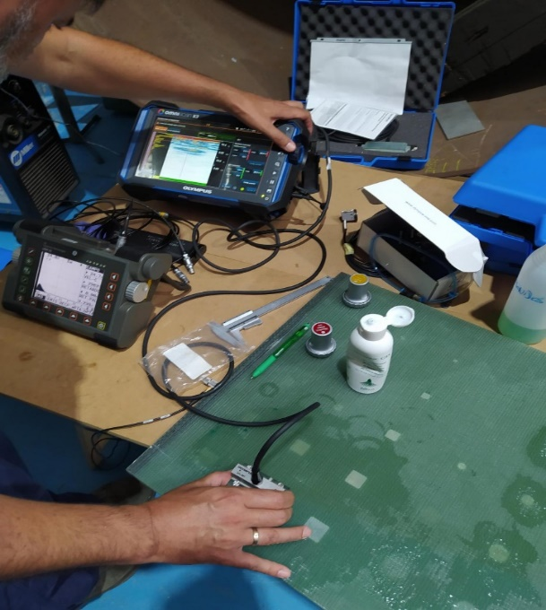
Ultrasound Testing (UT)
Based on the detection and the feature extraction of the ultrasonic waves reflected by defects. UT works by sending ultrasonic waves through an object or material. These high frequency sound waves are transmitted into materials to characterise the material or for flaw detecting.
FEATURES
The depth of penetration for flaw detection is superior to other NDT methods
Sensitive to both surface and subsurface discontinuities
ISSUES
Surface must be accessible to transmit ultrasound
It requires a coupling medium
A technical expert required to acquire and interpreted the data
5th webinar | 19-02-2025 | online

Slide 12
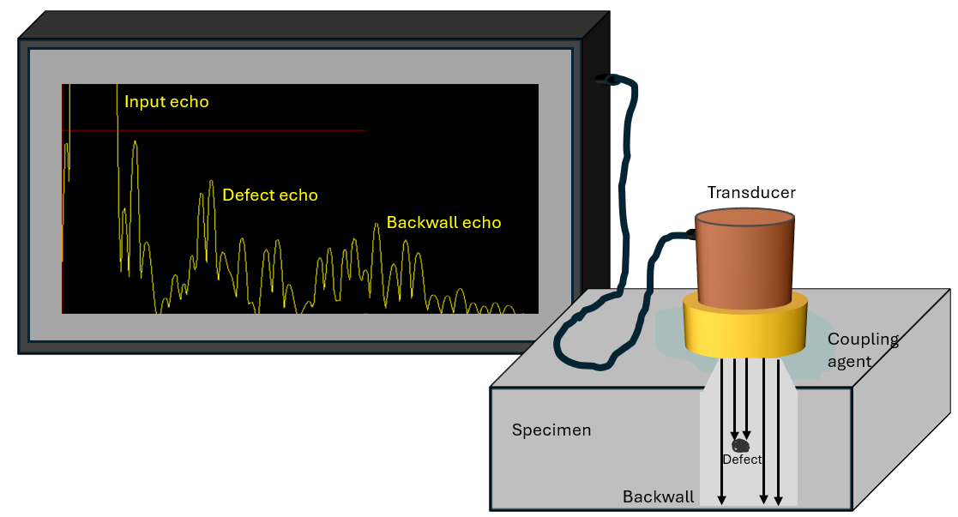
Ultrasound Testing: Pulse-Echo
Ultrasound pulse-echo devices are built with a transducer which produces a wide-band pulse that is subjected to the test material during testing. The pulse travels through the material until it meets with either discontinuity within the material or when it reaches a new medium. The wave is then scattered or reflected back to the transducer.
No defect: The echo passes through the part and returns to the receiver, showing only the input and output signals.
Delamination: Detected by the receiving signal. The output signal decreases considerably or even disappears if the delamination is large compared to the input signal.
Porosity: Detected because noise appears between the input and output signals, but unlike a delamination, the signal is not lost as long as the porosity is not too high.
5th webinar | 19-02-2025 | online

Slide 13
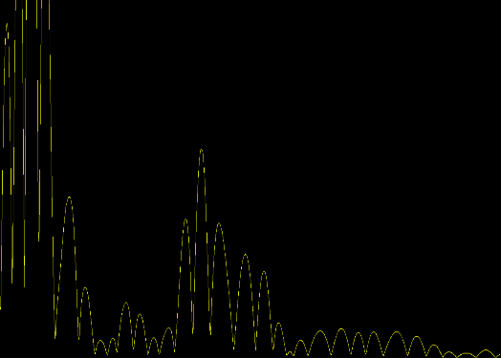
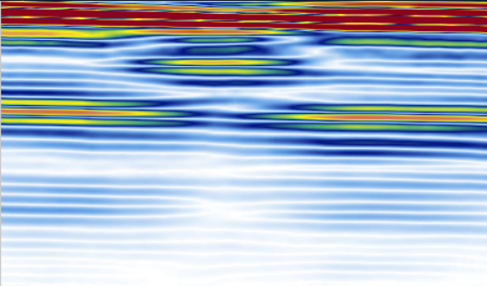
Ultrasound Testing: Representation
A-Scan: radio-frequency waveform presentation showing the time and amplitude of an ultrasonic signal.
S-Scan: image that represents a cross-sectional view derived from a series of A-scans.
Amplitude
Depth
Time
Width
B-Scan: image showing a cross-sectional profile through one vertical slice of the test piece.
C-Scan: two-dimensional presentation of data displayed as a top view of a test piece.
Depth
Width
Time
Time
5th webinar | 19-02-2025 | online

Slide 14
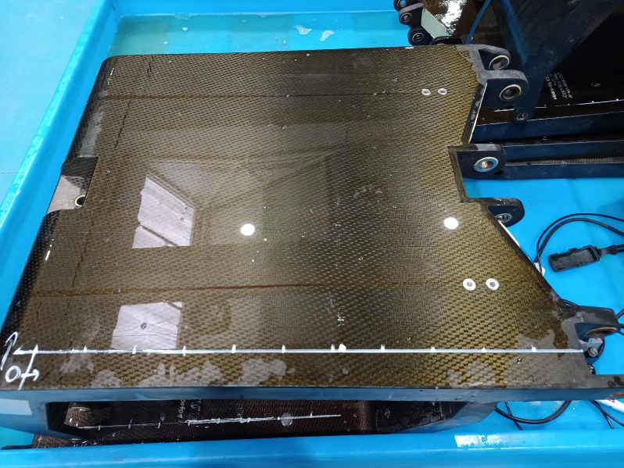
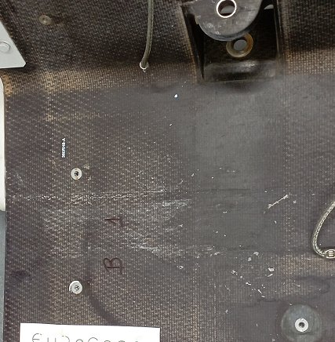
Thermography and Ultrasound Testing Tool (TUTT)
AIMEN developed its own software for working with Non-Destructive Testing methods
Application uploaded to EuReComp Zenodo: https://zenodo.org/records/13833956
5th webinar | 19-02-2025 | online

Slide 15
Identification technologies
Chemical recycling of composites is a very active topic for fiber-reinforced polymer matrix: solvolysis
In-situ material identification is one the challenges for chemical recycling of End-of-Life composite waste utilizing solvolysis methods
OBJECTIVE: To develop innovative identification systems by means of spectroscopic techniques and advanced data processing algorithms:
Hyperspectral Imaging (HSI)
Laser Induced Breakdown Spectroscopy (LIBS)
Raman Spectroscopy
Chemometrics and machine learning
5th webinar | 19-02-2025 | online

Slide 16
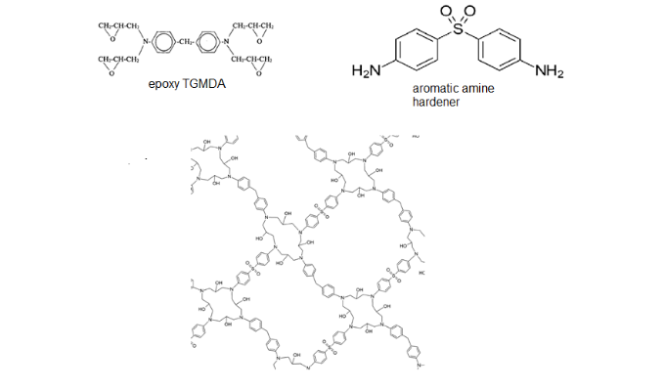
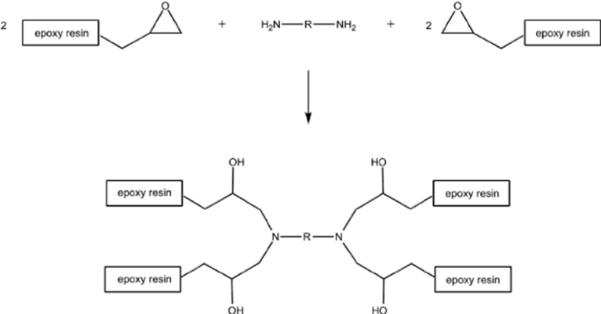
Thermoset matrix samples
 | Resin type | Hardener type
#1 | Epoxy | Aliphatic Polyamines
#2 | Epoxy | Aliphatic polyamine
#3 | Epoxy | Aliphatic Polyamines
#4 | Epoxy | Aromatic amine
#5 | Vinylester | Methyl ethyl ketone peroxide
#6 | Polyester | Methyl ethyl ketone peroxide
Epoxy
aromatic amine
polyamine
Vinylester
Polyester
5th webinar | 19-02-2025 | online

Slide 17
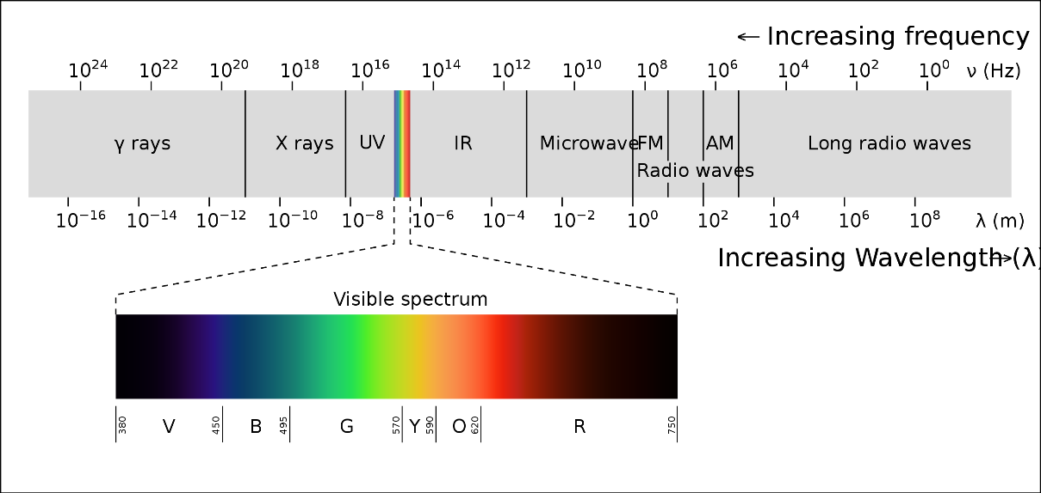
Hyperspectral imaging
It combines the power of digital imaging and spectroscopy.
Every pixel in the image provides local spectral information across a large number of spectral bands.
spectral data → used to chemically identify the materials.
spatial data → to get the spatial distribution of each material along the sample.
Intensity
Wavelength λ
1st EuReComp workshop, 2023/04/20, Dresden
5th webinar | 19-02-2025 | online

Slide 18
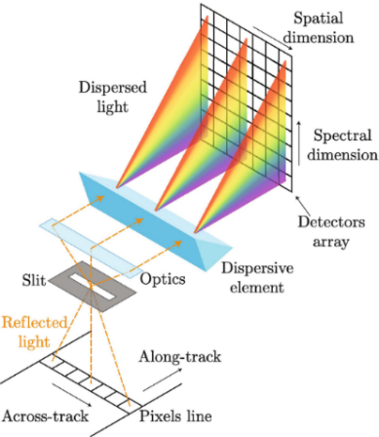
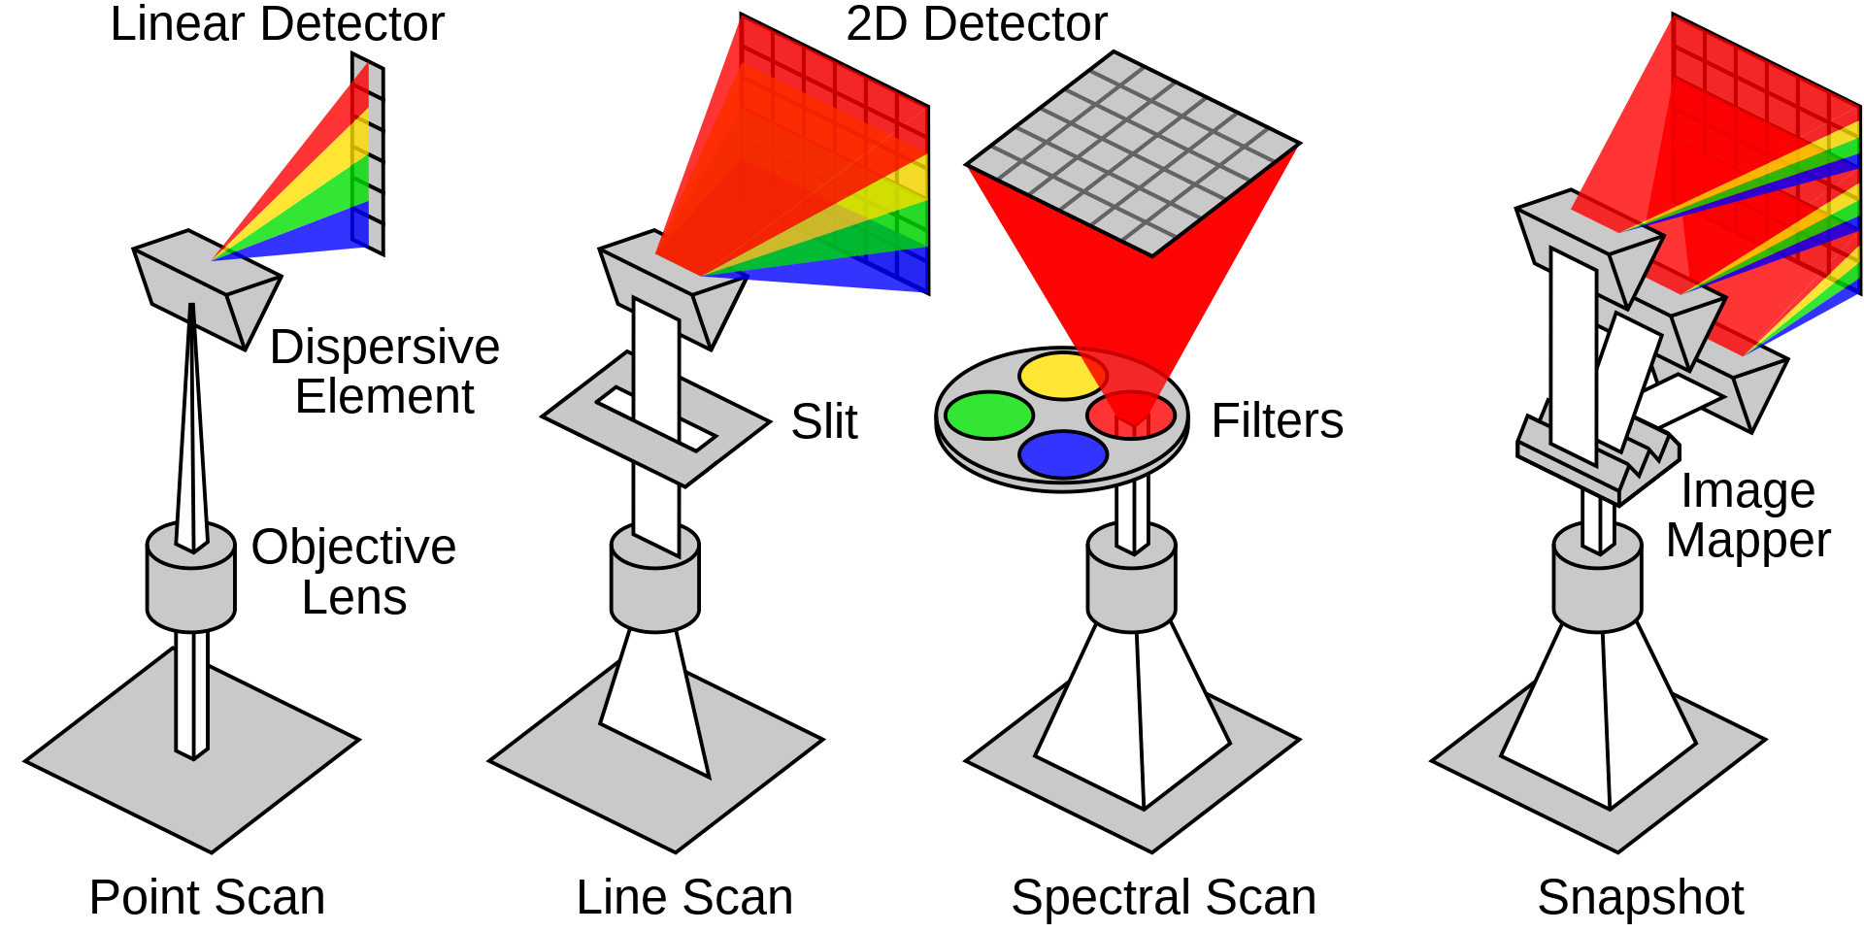
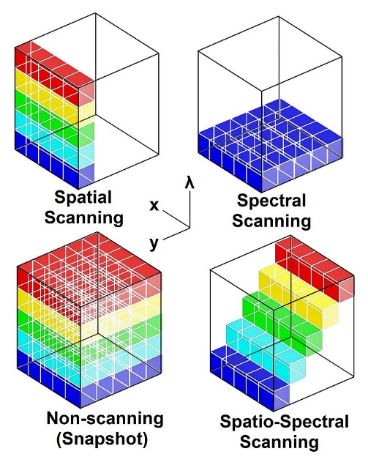
Hyperspectral imaging
Multi&Hyperspectral Imaging Scanning Techniques
5th webinar | 19-02-2025 | online
5th webinar | 19-02-2025 | online

Slide 19
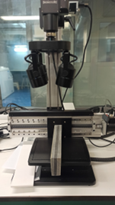
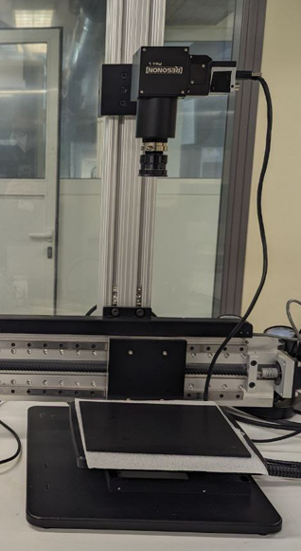
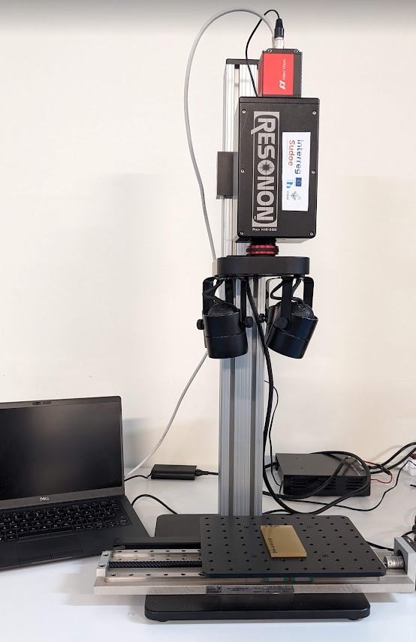
Hyperspectral imaging
Silicon Sensor​
InGaAs Sensor
400 – 1000 nm
2.1 nm resolution
300 spectral channels
900 spatial channels
900-1700 nm
4.7 nm resolution
168 spectral channels
900 spatial channels
Halogen
lamps
Sample
Reflection & transmission
Reflection
5th webinar | 19-02-2025 | online

Slide 20
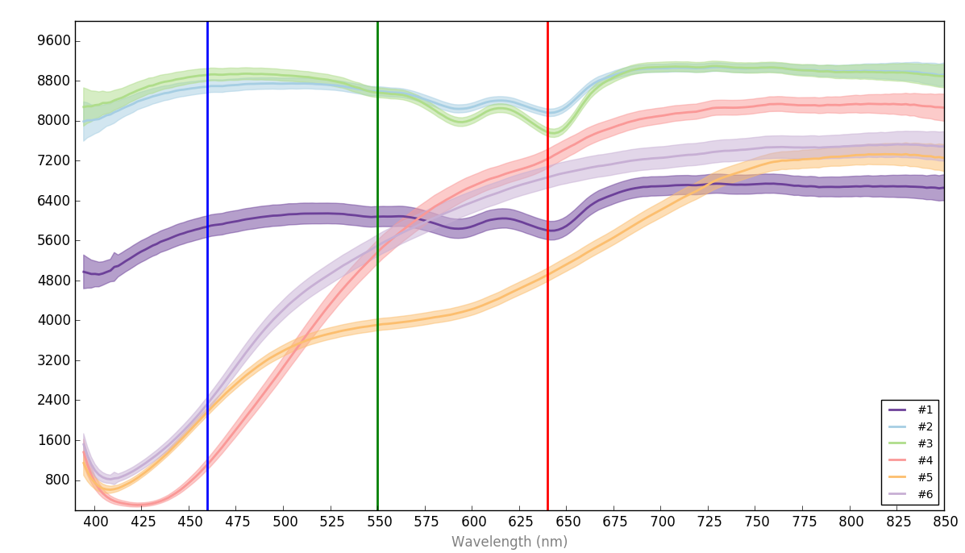
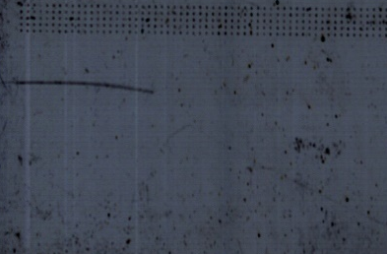
Hyperspectral imaging
SWIR
Optical characterization in VIS and SWIR spectral ranges
VIS
#1 #2
#3 #4
#5 #6
Red: 640 nm
Green: 550 nm
Blue: 460 nm
5th webinar | 19-02-2025 | online
5th webinar | 19-02-2025 | online

Slide 21
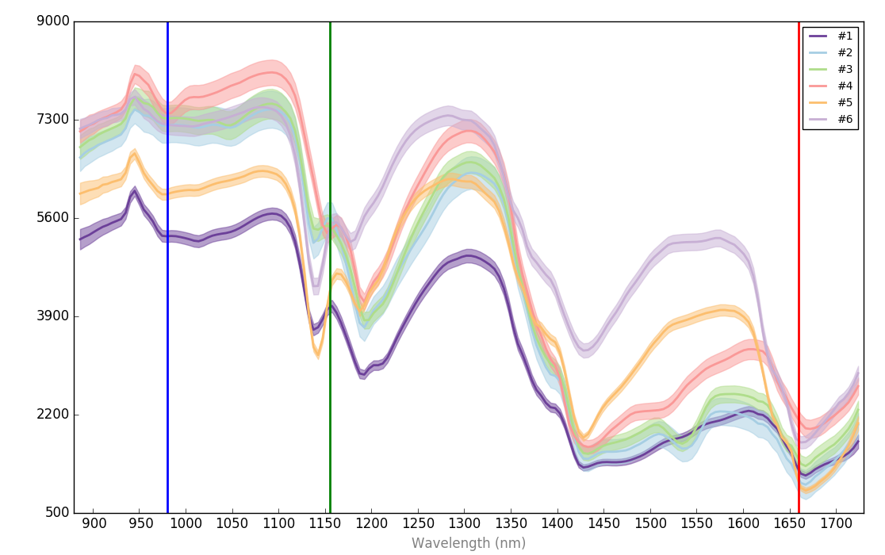
Hyperspectral imaging
SWIR
Optical characterization in VIS and SWIR spectral ranges
SWIR
Red: 1660 nm
Green: 1155 nm
Blue: 980 nm
From the reflectance spectra, distinctive spectral bands for the different materials can be identified. Those bands (feature selection) can be used for discrimination models
Absorption peaks in #2, #3 at 1550nm
5th webinar | 19-02-2025 | online

Slide 22
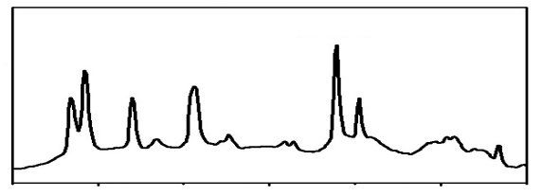
Laser Induced Breakdown Spectroscopy (LIBS)
Optical emission spectroscopic technique based on analysis of plasma generated during laser ablation -> provides information about chemical composition of sample
FEATURES:
No sample preparation required
Multiple element detection
Qualitative and quantitative analysis
In-situ and fast analysis
Surface & depth-profiling technique
Versatility (material types and forms)
High power laser pulse ablation
High temperature plasma creation
Sample elements emits specific wavelength
(public database available)
Light emission as the plasma cools
Emission spectrum
Crater on sample ( ~μm)
Intensity
400 500 600
Wavelength (nm)
5th webinar | 19-02-2025 | online

Slide 23
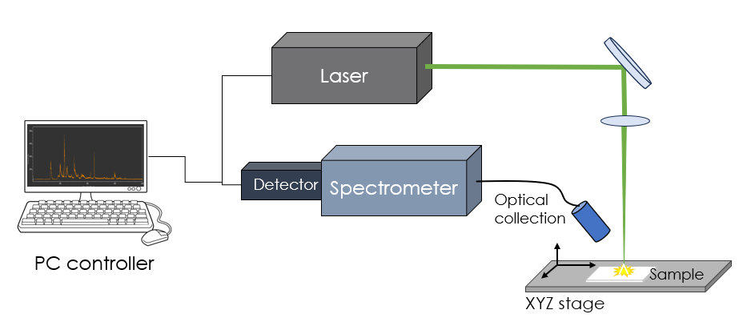
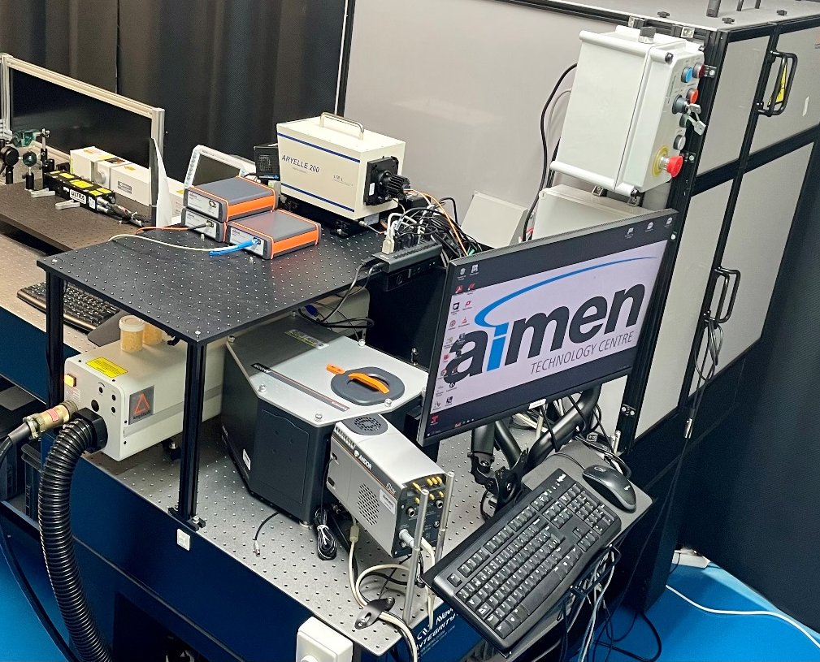
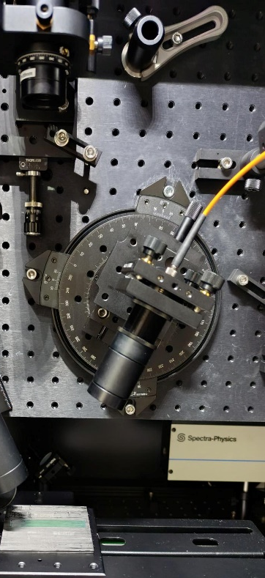
Laser Induced Breakdown Spectroscopy (LIBS)
Lasers
Echelle spectrometer
Field spectrometer(s)
Excitation Laser
(wavelength, pulse duration, pulse energy, rep. rate)
Focusing optics
(focal length –> spot size)
Optical collection
(magnification, spectral range)
Spectrometer and detector
(spectral resolution, efficiency and time-resolved capabilities)
XYZ stage
(precision, travel range)
Focussing optics
Laser
Lab spectrograph
& iCCD
Optical collection
Workstation PC for data acquisition and data analysis
Sample
Automated XYZ stage
5th webinar | 19-02-2025 | online

Slide 24
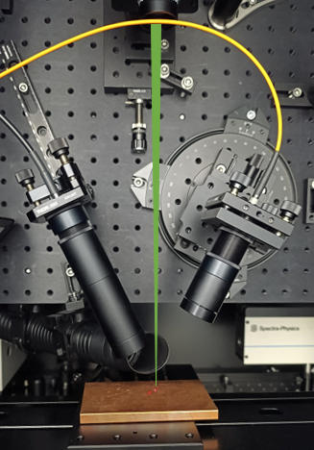
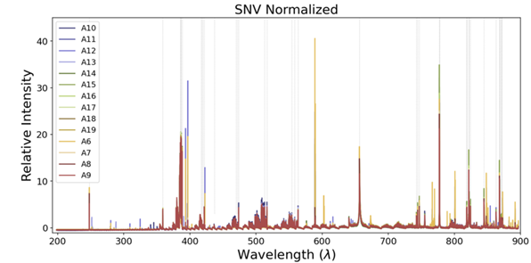
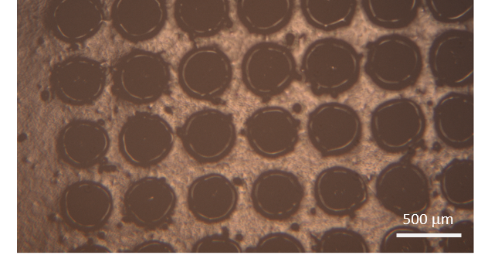
LIBS spectra measurement
5th webinar | 19-02-2025 | online
5th webinar | 19-02-2025 | online

Slide 25
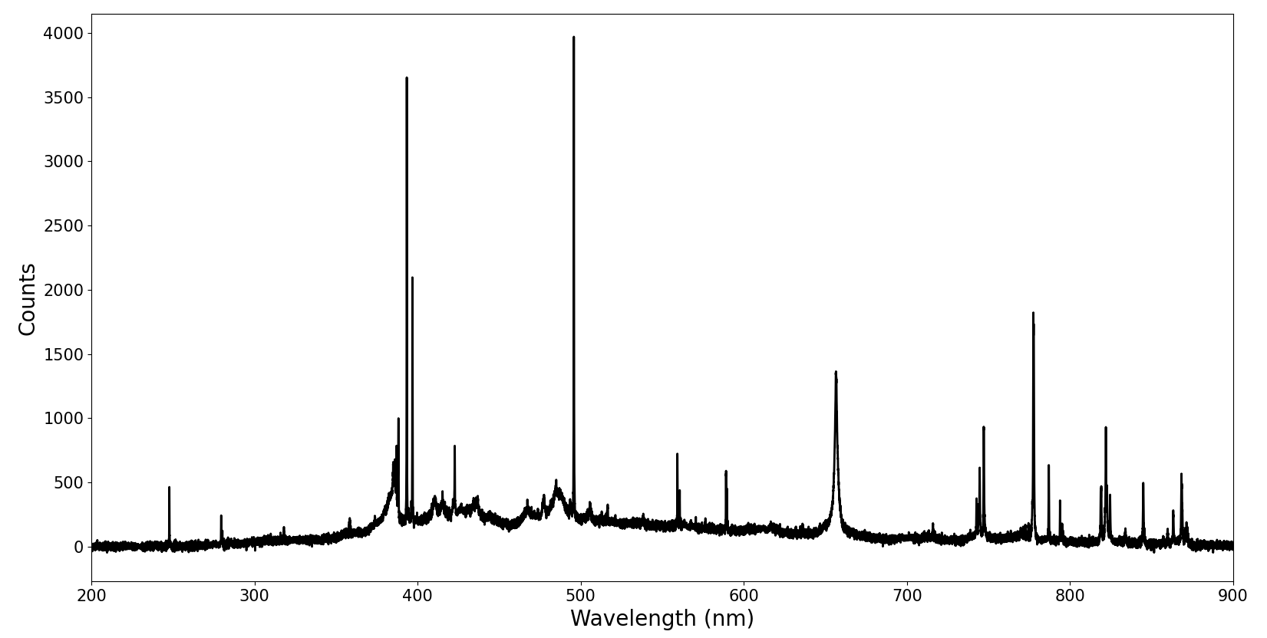
LIBS spectra on thermosets
To identify the emission lines
5th webinar | 19-02-2025 | online

Slide 26
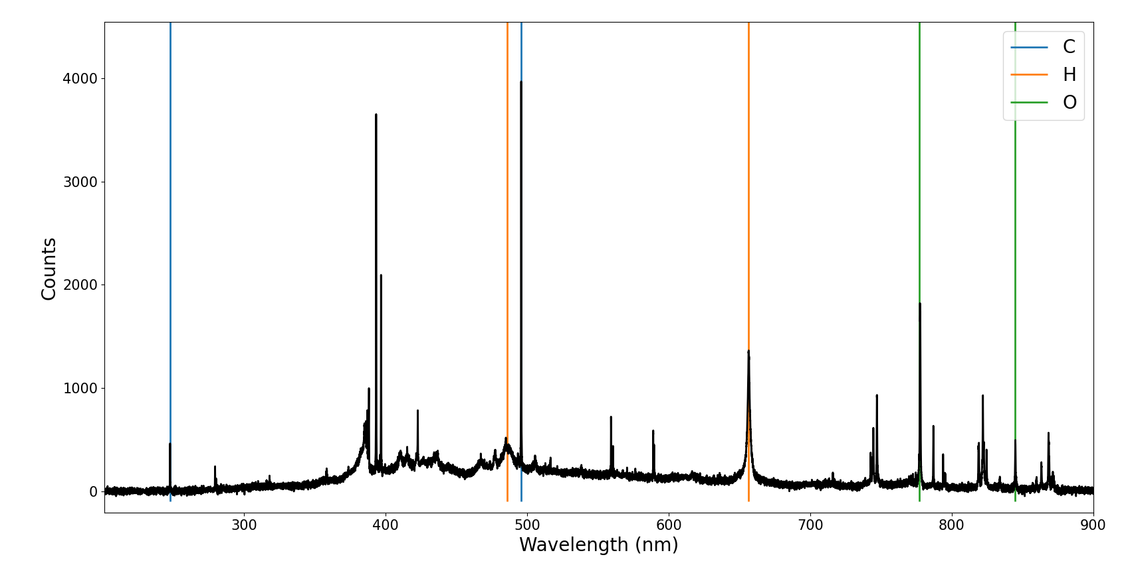
LIBS spectra on thermosets
Atomic emission lines
5th webinar | 19-02-2025 | online

Slide 27
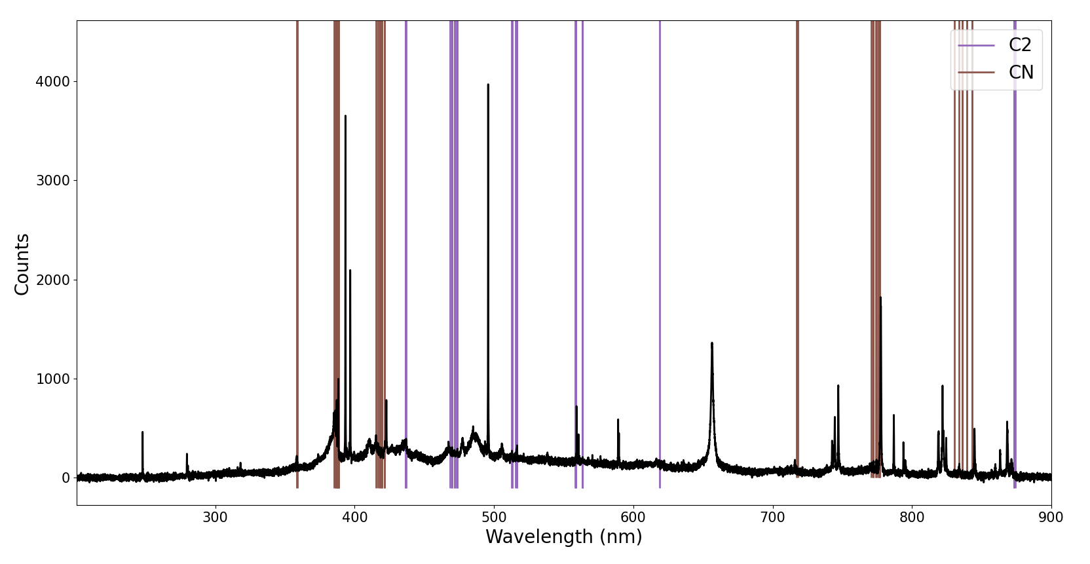
LIBS spectra on thermosets
Molecular emission lines
5th webinar | 19-02-2025 | online

Slide 28
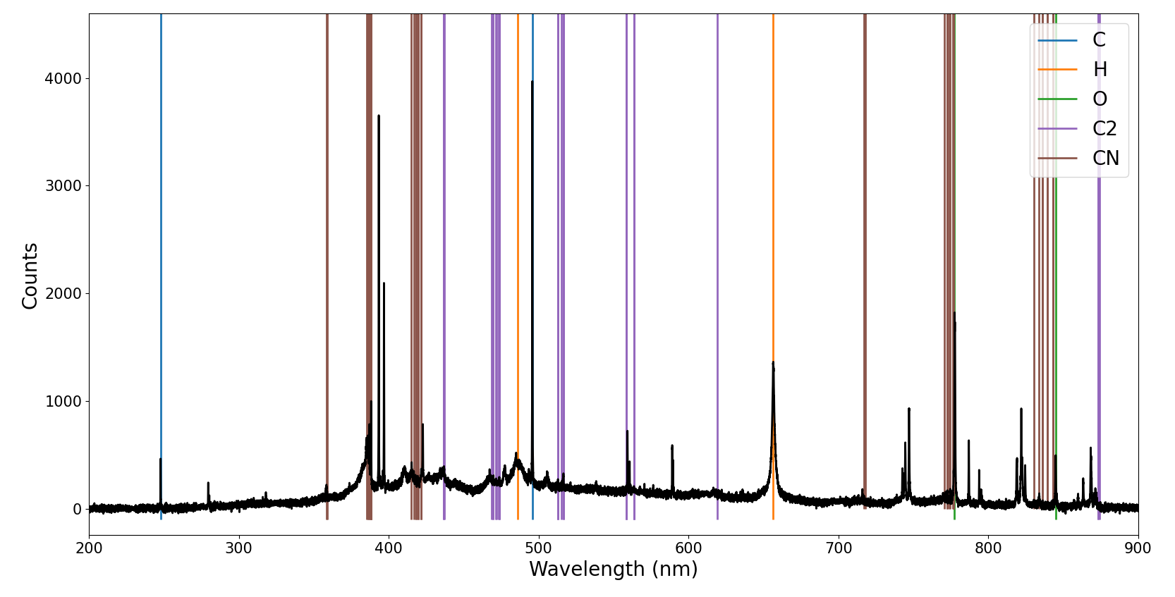
LIBS spectra on thermoset resins
5th webinar | 19-02-2025 | online

Slide 29
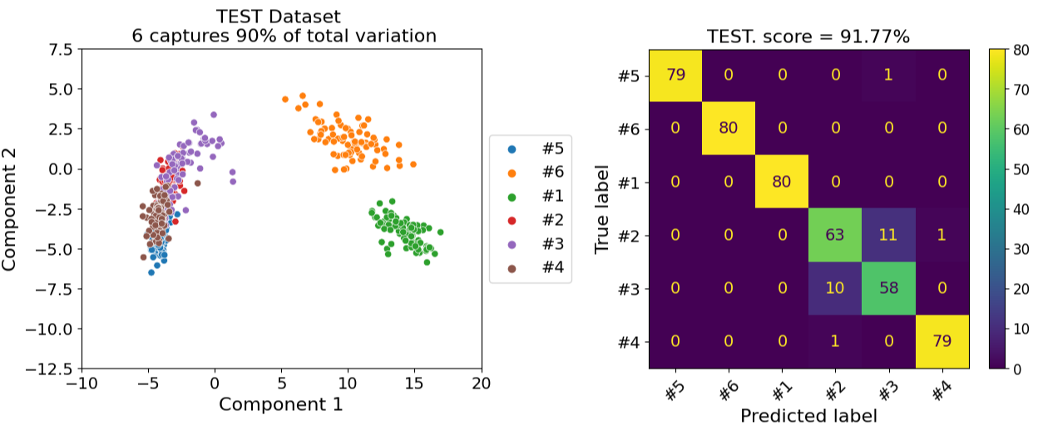
Laser Induced Breakdown Spectroscopy (LIBS)
MATRIX CLASIFICATION
Experimental data
LIBS spectra
Normalization
Table of features
Feature selection and dimensionality reduction
Classification algorithms
5th webinar | 19-02-2025 | online

Slide 30
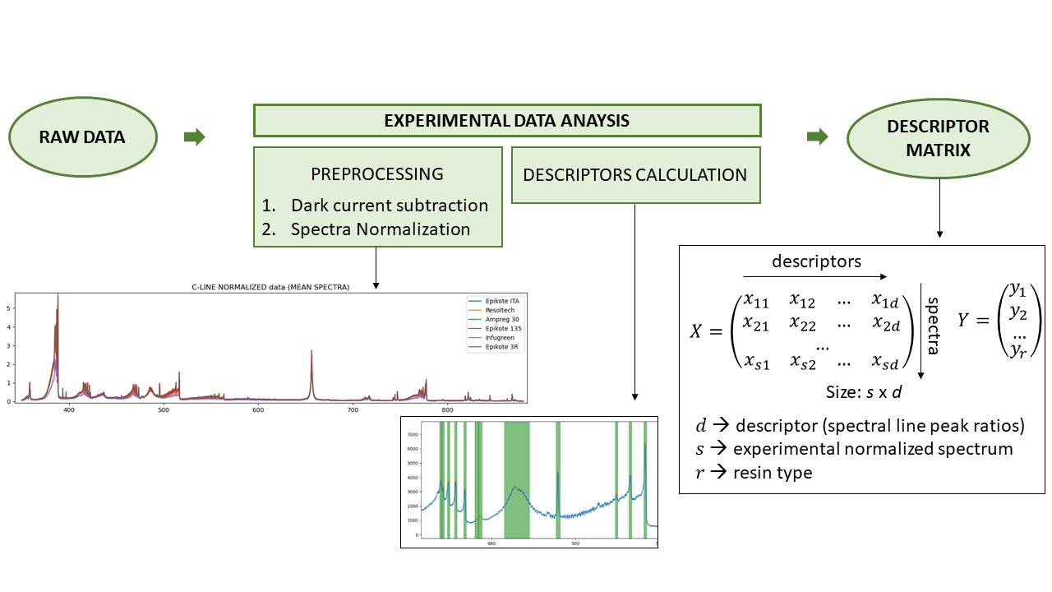
Laser Induced Breakdown Spectroscopy (LIBS)
MATRIX CLASIFICATION
Experimental data
LIBS spectra
Normalization
Table of features
Feature selection and dimensionality reduction
Classification algorithms
5th webinar | 19-02-2025 | online

Slide 31
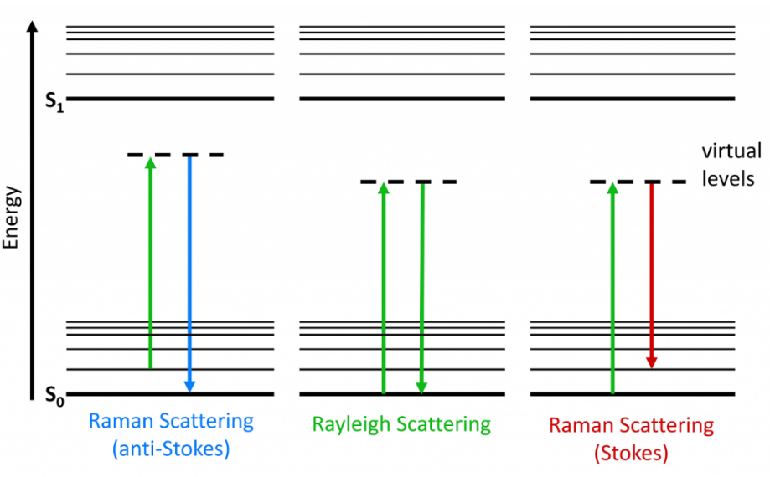
Raman Spectroscopy
UNDERLYING PRINCIPLE
Inelastic scattering of laser light by material surface: los (gain) to molecular and lattice vibrations
Excitation to and subsequent relaxation from virtual energetic levels
FEATURES
Detailed molecular structure information from vibrational modes. Material specific emission peaks
Non destructive technique
Comparably weak signal
Organic and inorganic materials.
Not affected by wáter interference, unlike IR spectroscopy.
Most common use is materials ID (fingerpint)
Laser excitation in UV, VIS or NIR
5th webinar | 19-02-2025 | online

Slide 32
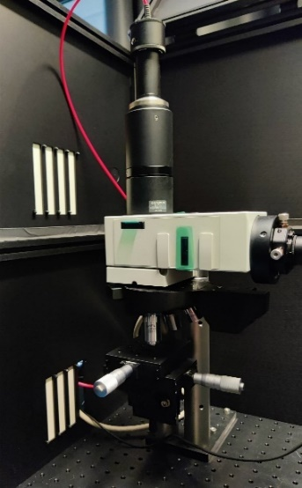
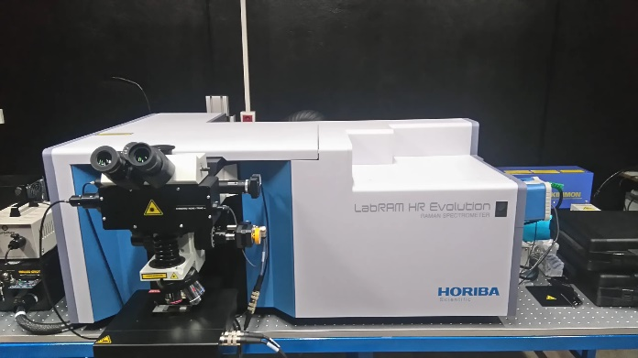
Raman Spectroscopy
Spectrometer
Main components and parameters
Laser excitation source
Peak wavelength & power
Optical collection system
Probe geometry and type
Spectra detection
Spectral range, resolution, Dark noise
Baseline and fluoroscence removal
Spectra - > Raman shift calculation
Laser
Notch filter
Beam splitter
Microscope
objective
Sample
Raman setup at Aimen
Raman microscope at Patras University
5th webinar | 19-02-2025 | online

Slide 33
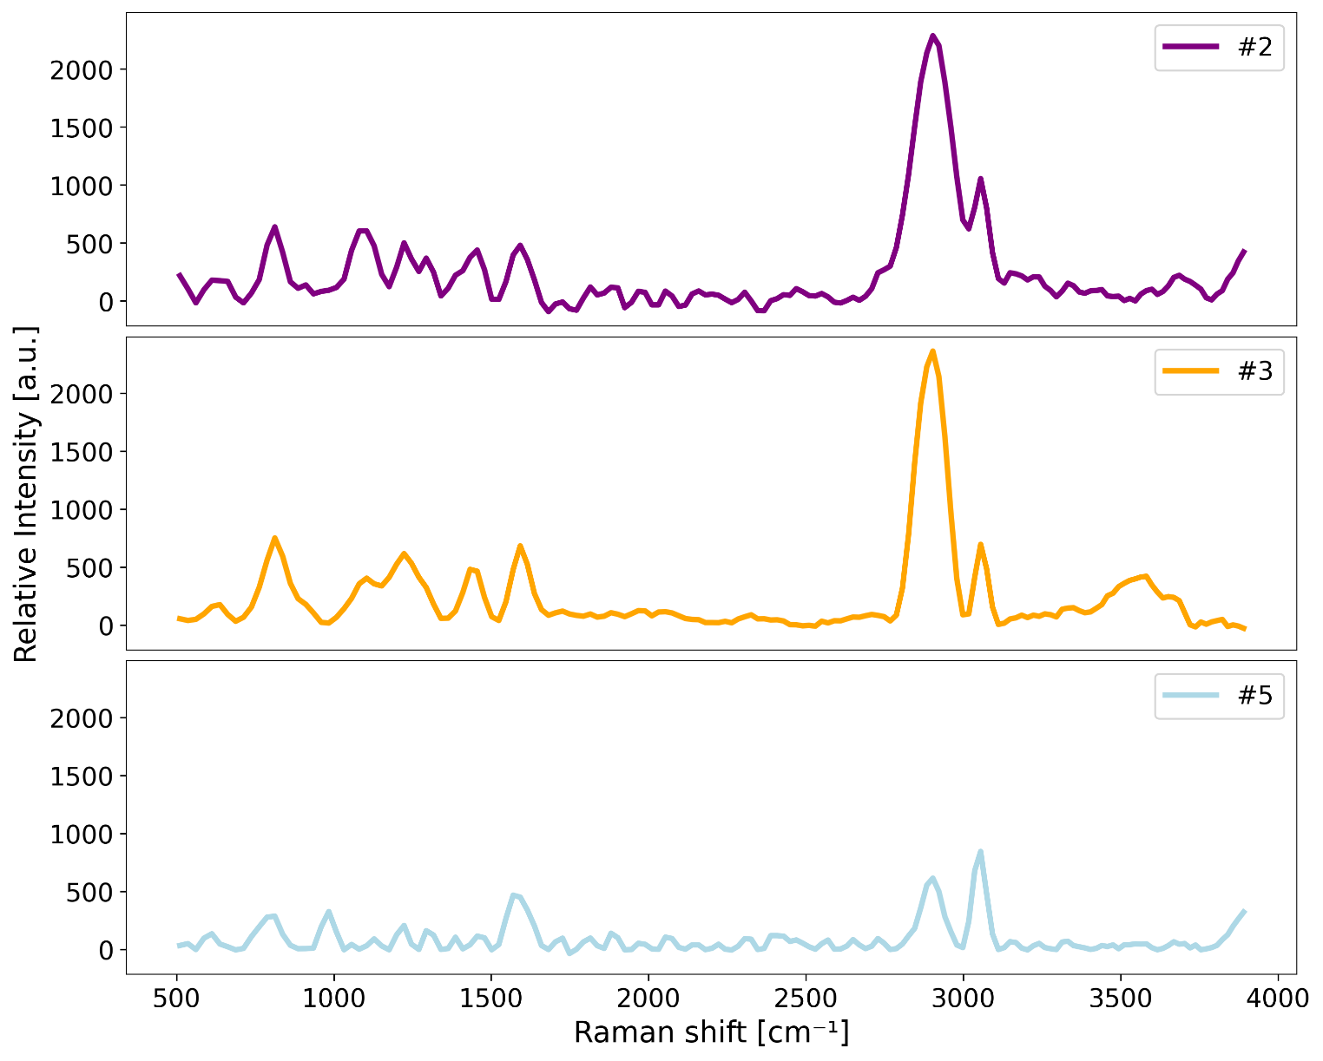
Raman Spectroscopy
Individual Raman peaks can be assigned to specific vibrational modes of the analysed molecule
Material-specific lines allow for its identification and differentiation from other materials
5th webinar | 19-02-2025 | online

Slide 34
Raman Spectroscopy
Individual Raman peaks can be assigned to specific vibrational modes of the analysed molecule
Material-specific lines allow for its identification and differentiation from other materials
5th webinar | 19-02-2025 | online

Slide 35
Conclusions
Technologies for enabling informed decisions for material circularity pathways
Active Thermography
Ultrasound Testing
Hyperspectral Imaging
Laser Induced Spectroscopy Analysis
Raman Spectroscopy
The methods and software developed allow inspection of parts and detection of defects, as well as material changes -> Support decision whether to repair, reuse or recycle a component
Systems and experimental protocols coupled with machine learning algorithms enables differentiation of matrix of fiber-reinforced EoL composites -> Support recyclers on solvolysis optimization
5th webinar | 19-02-2025 | online

Slide 36
Miguel Gómez
Miguel.gomez@aimen.es
Camilo Prieto
Camilo.Prieto@aimen.es
AIMEN Technology Centre
5th webinar | 19-02-2025 | online

