Slide 1




The Digital Leap: Enhancing End-of-Life Recovery with Digital Product Passports in aerospace, automotive and wind energy sectors

Slide 2
Content
Content Overview
Circularise overview
About the EuReComp EU project
Roundtable discussion
Questions

Slide 3





Round table
The speakers
Hosted by:
Kate Trompeta
Thomai Tiriakidou
Chiara Pernechele
Maria A Léon
Phil Brown
Chemical Engineer, Researcher
Dipl. Mechanical Engineer, head of Research projects department
Material Science Senior Engineer
Research Manager
Head of Sustainable Innovation
NTUA
B&T Composites
Dallara
Circularise
Circularise

Slide 4
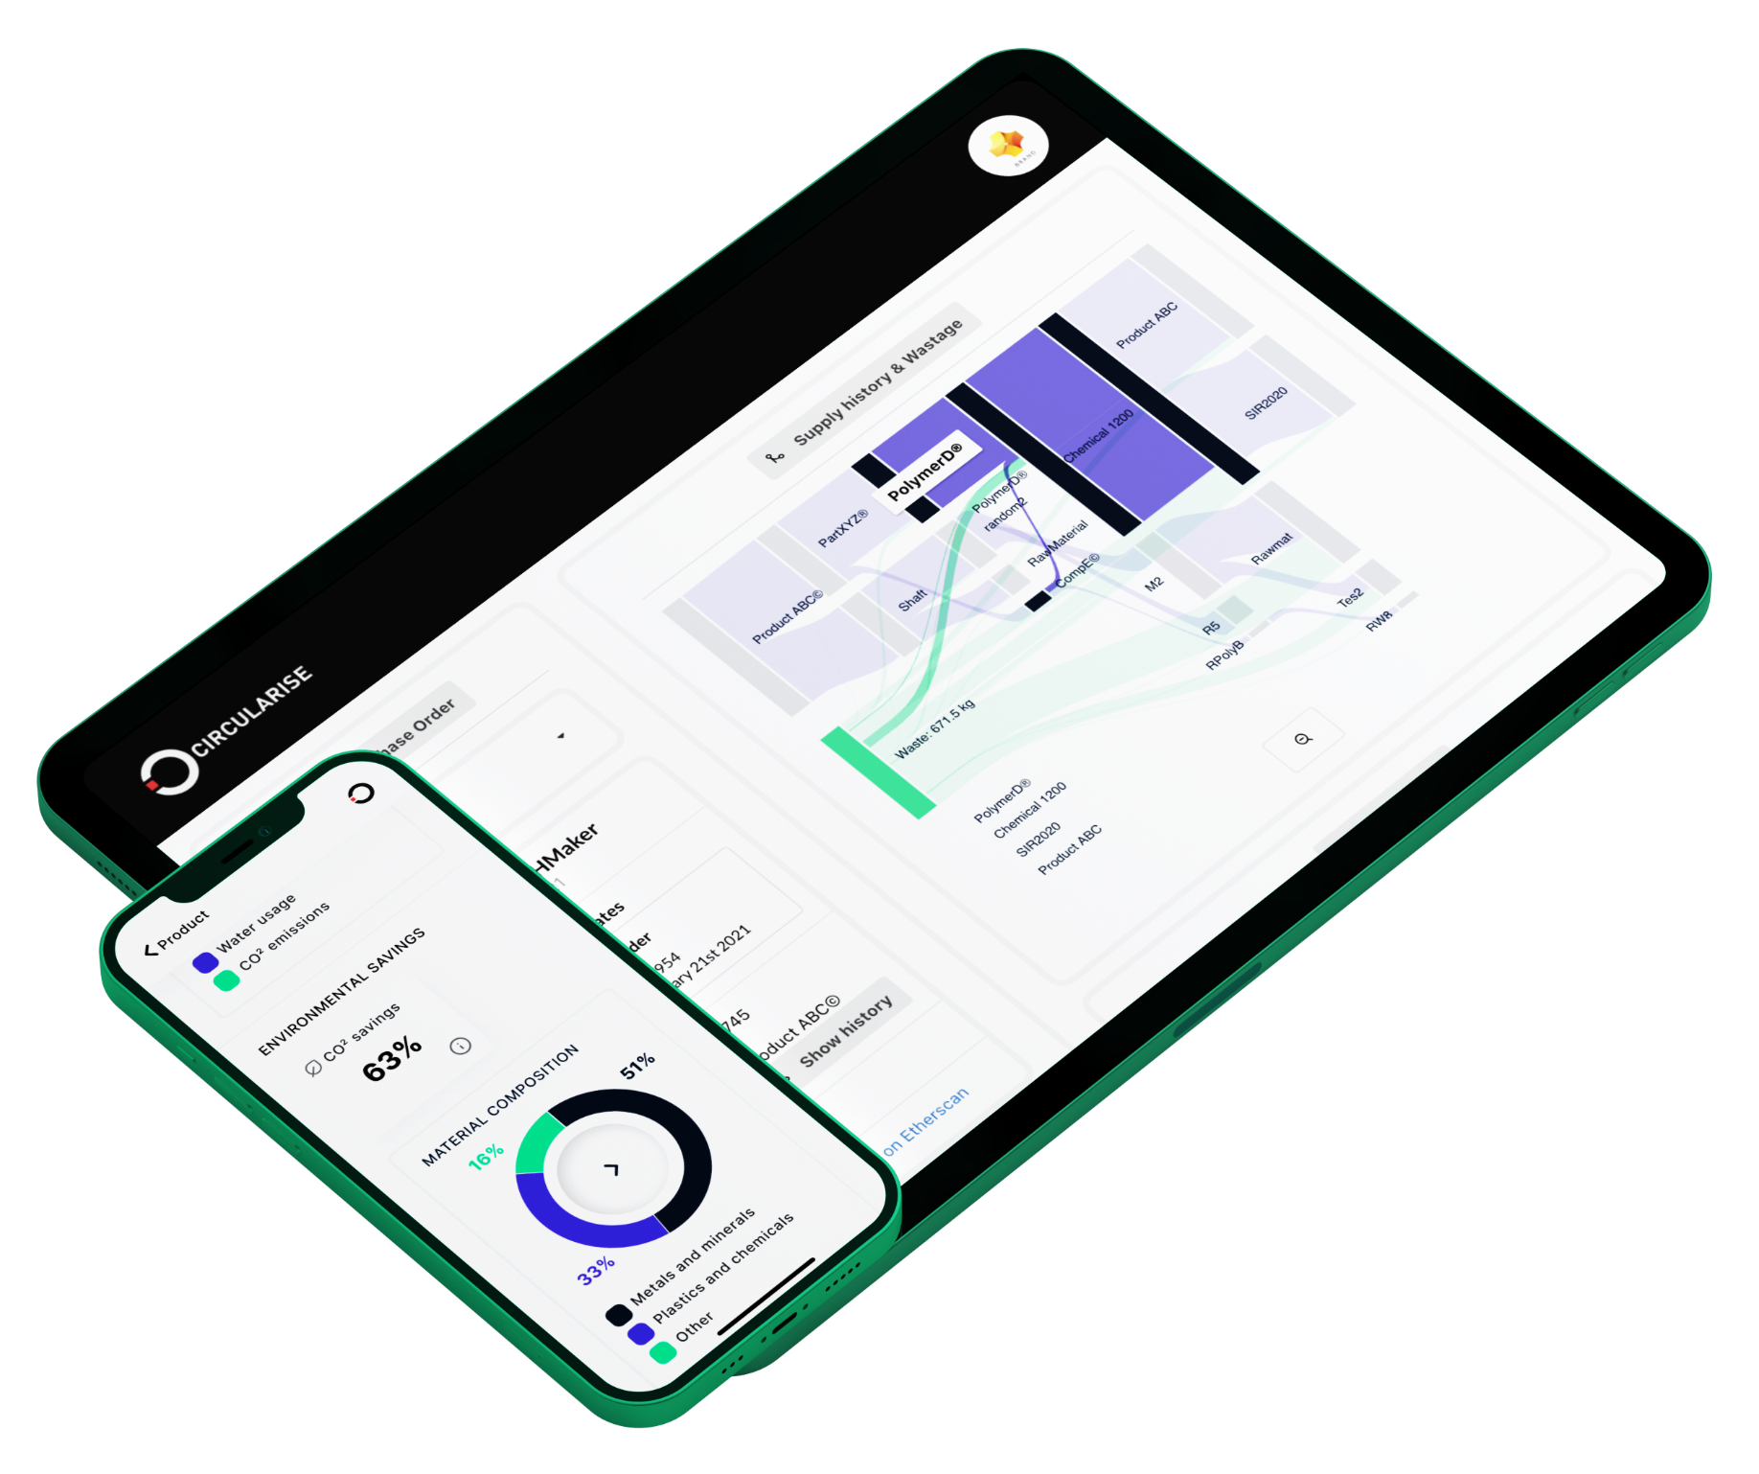
Bringing traceability to global supply chains and empowering businesses to take steps towards a circular economy with digital product passports
Company Profile
HQ The Hague, Netherlands
Established 2016
Employees >40
Patents Smart Questioning
Notes:
Good afternoon everybody and welcome to this webinar
My name is Maria Alejandra León, I am EU project Manager at Circularise and I will be presenting Circularise and the outcomes of the EuReComp project.
At Circularise we are committed to achieving circularity and maximizing resource efficiency, which is why I'm thrilled to have you all here today to talk about foam recycling and its challenges around logistics and data. Given our experience with the EU funded Circular Foam project.
Circularise is a SME based in the NL that has developed a platform for secure data sharing among value chain stakeholders

Slide 5

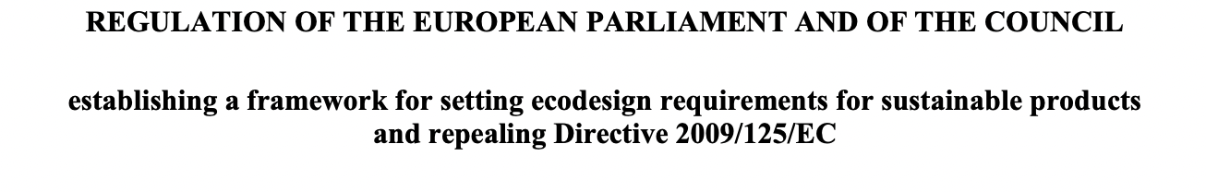

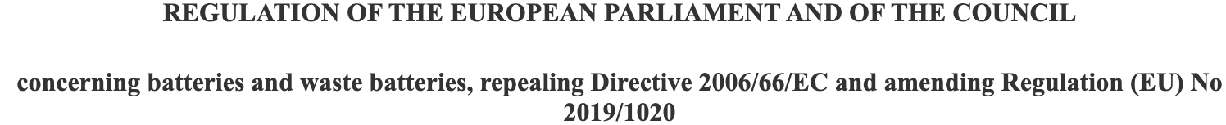
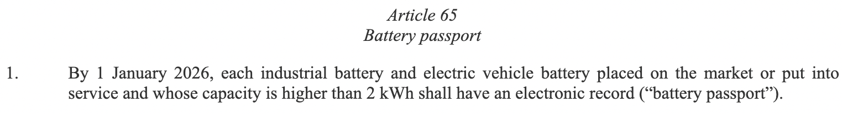
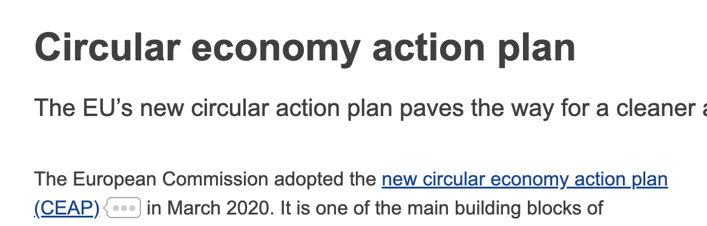
TRENDS
Regulations and Sustainability Targets - Digital product passport
Suppliers are being asked for information to understand:
What materials reduce vehicles’ embodied carbon?
Which parts are easier to disassemble and recycle?
How does design impact the end-of-life of vehicles?
BY TRACING SUPPLY CHAINS, SUPPLIERS CAN BETTER ANSWER THESE QUESTIONS
Overview of upcoming regulations available here
Notes:
Traceability is gaining importance among value chains.
Companies are everyday more interested in tracing their components, in getting information about the materials, the processes, environmental impacts given the increasing regulations around data transparency and overall due diligence.
DPPs are an example of this, scheduling batteries as the first industry to take effect in 2027, and afterwards continuing with all other sectors.
Additionally, given the commitments around targets for climate change, sustainability initiatives have appeared, for example the green deal, the Circular Economy Action plan.
In general, all these efforts and regulations require one thing: Data availability among supply chains

Slide 6
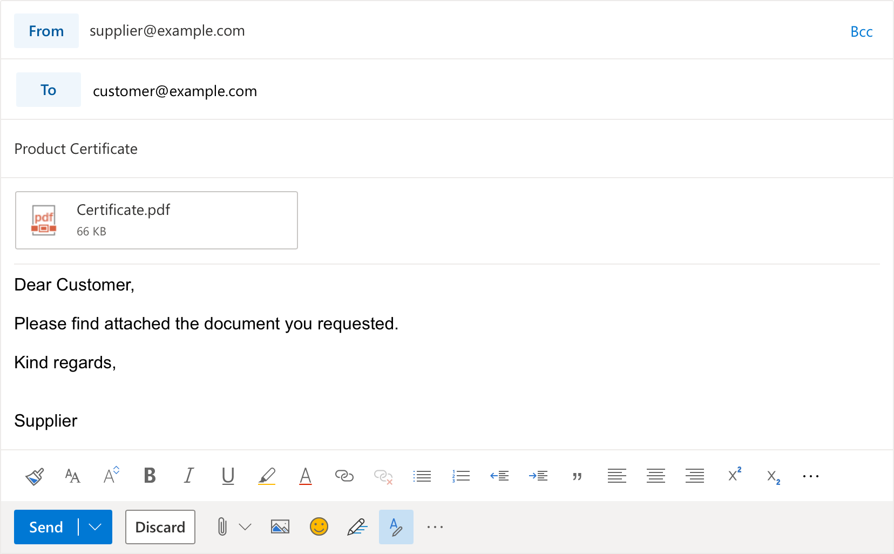

THE PROBLEM
Traceability today
No efficient solution
· Labour intensive
· Prone to error and/or fraud
· Usually reactive
· Not scalable
Notes:
However, current means of data gathering involve emails among stakeholders, which can be time consuming, susceptible to fraud and to security breaches.

Slide 7
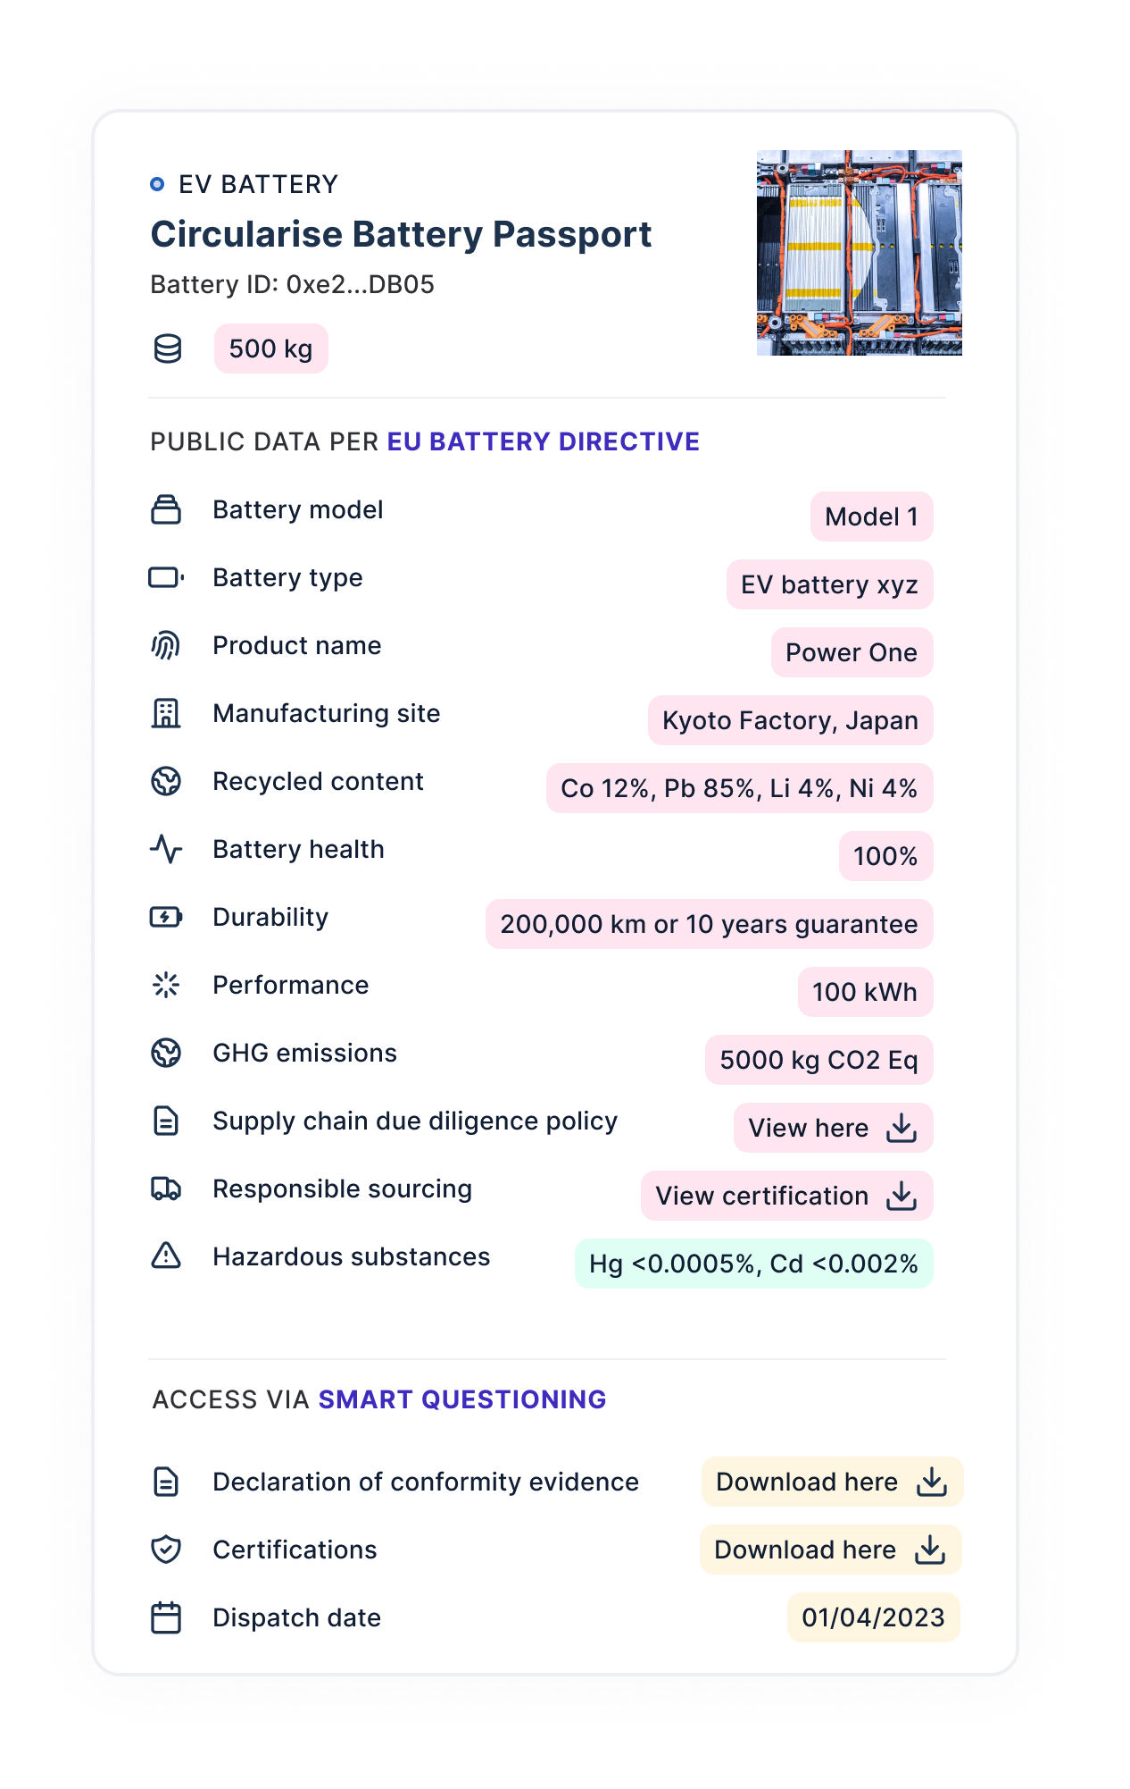


BATTERY PASSPORT EXAMPLE
The Circularise passport
Notes:
This is where Circularise comes. Providing a tool that enables to securely share sensitive information among value chains.
Suppliers can now create DPP, and share key information to their customers, without endangering their Intellectual Property and competitive advantage.
Information such as sourcing, chemical composition, technical properties, and environmental assessments is now available throughout the value chain

Slide 8
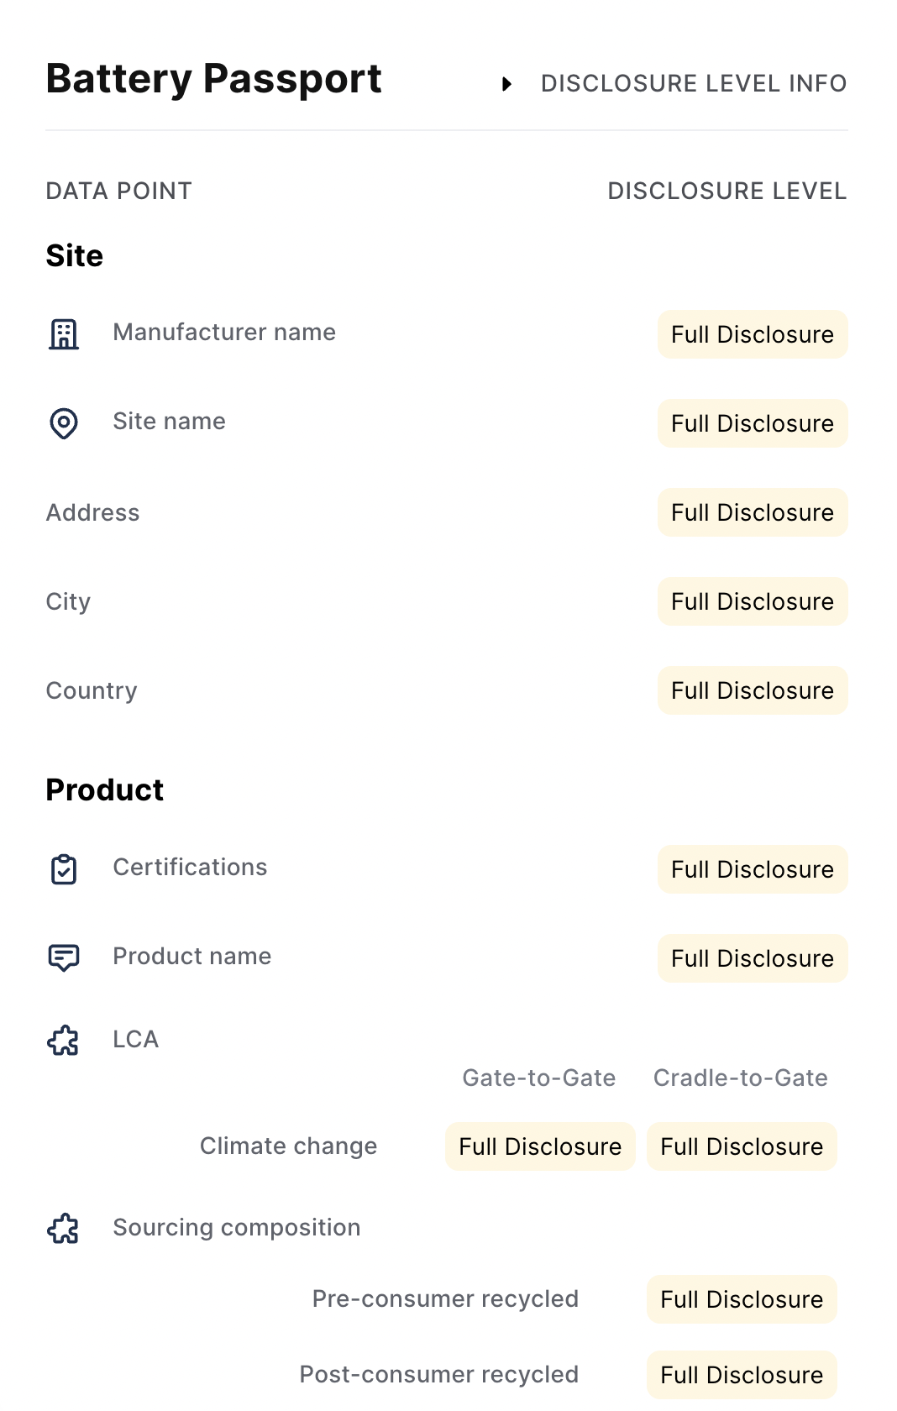
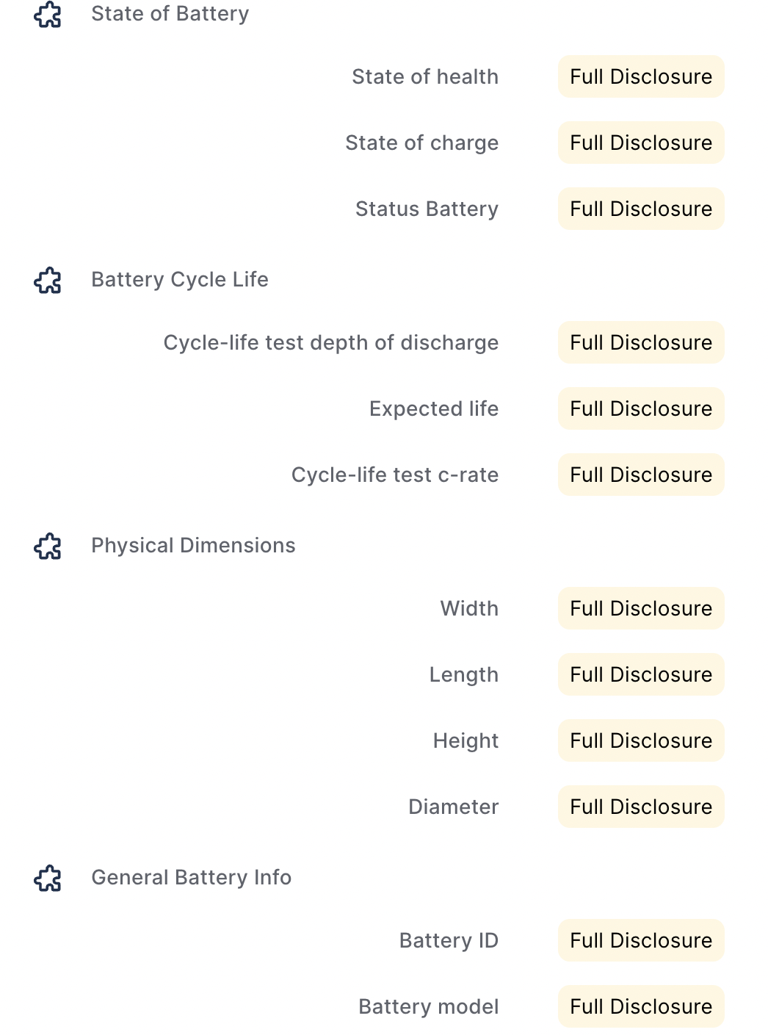
SMART QUESTIONING
Alignment with standards
Passport data points aligned with established frameworks
Standards: e.g. ISO, GHG protocol
Certifications: e.g. ISCC, RSB
Regulations: e.g. EU battery directive, GSCA (LkSG)
Supplier requirements: e.g. GHG emissions, social responsibility
Notes:
All this data availability enables to comply with different regulations, standards, certifications, or even specific OEM supplier requirements.
And stakeholders among the value chain can agree upfront on which questions to ask, and data to trace

Slide 9





BENEFITS OF TRACEABILITY
Value of DPPs
Track sourcing, CO2 footprint, LCA, certifications and other sustainability metrics
Share safety, and technical product specifications
Enables regulatory and standards compliance
Mitigate risks across the supply chain
Enables new revenue streams by charging a premium or establishing service models
Notes:
In general, DPP enable
To perform impact assessments, as well as to provide proof for certifications and claims around improvement of for example sustainability metrics
It is possible to share data that supports process improvement and better resource allocation, as more informed decisions can be taken
In the end, this also facilitates overall compliance
And thus risk mitigation and supply chain resilience
Finally, by having data transparency and value chain visibility, new business models can be developed. For example with the chemical and material information, EoL components can be better recycled or even have new product designs with extended lifecycles.

Slide 10

EuReComp project overview
Notes:
An example of this is the eurecomp project

Slide 11
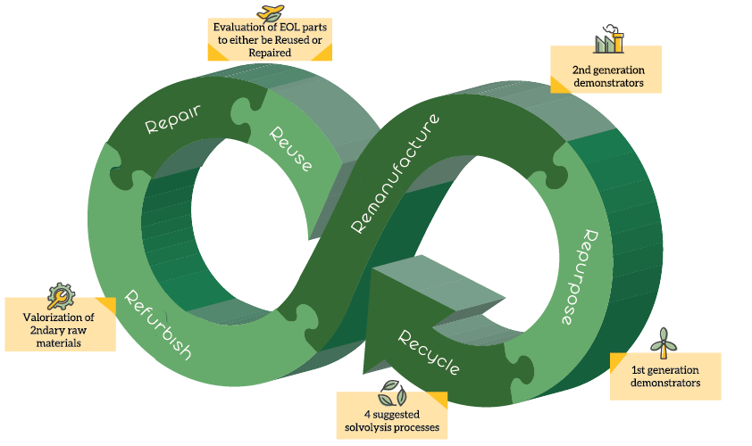
Project Overview
EuReComp Project
Notes:
The eurecomp project aims to provide sustainable methods towards recycling and reuse of composite materials, coming from components used in various industries, such as aeronautics and wind energy.

Slide 12







Circularise’s work overview
EuReComp Project - Traceability tools
Circularise provides dynamic tools for efficient material lifecycle management and secure information flow within the aerospace, automotive and wind turbine sectors.
Improved anonymous and private material data communication along the supply chain to provide transparency, automatic reporting, material and production process data for circularity.
Crafting a comprehensive dashboard for real-time evaluation of materials.
Establishing a decentralised system enabling protected data exchanges along the supply chain.
Facilitating information updates and detailed inquiries tailored to stakeholders' needs.
Developing specialised functionalities for EoL operators to optimize waste collection and sorting.
Some partners
Notes:
Circularise contributes to this goal through improving traceability and information sharing in the value chains for better and more informed decision making.
Circularise has improved its digital tools to support the requirements from the aerospace, automotive and wind turbine sectors. This enable stakeholders in these value chains to securely share data throughout the different steps so that stakeholders downstream have greater visibility into the components, comply with regulations, prove claims such as recycled content, and improve their processes by having more information on the parts.
For example, EoL operators can now now if certain substances and chemicals are present in the components they receive, so they can use the most adequate process and maximise efficiency.

Slide 13
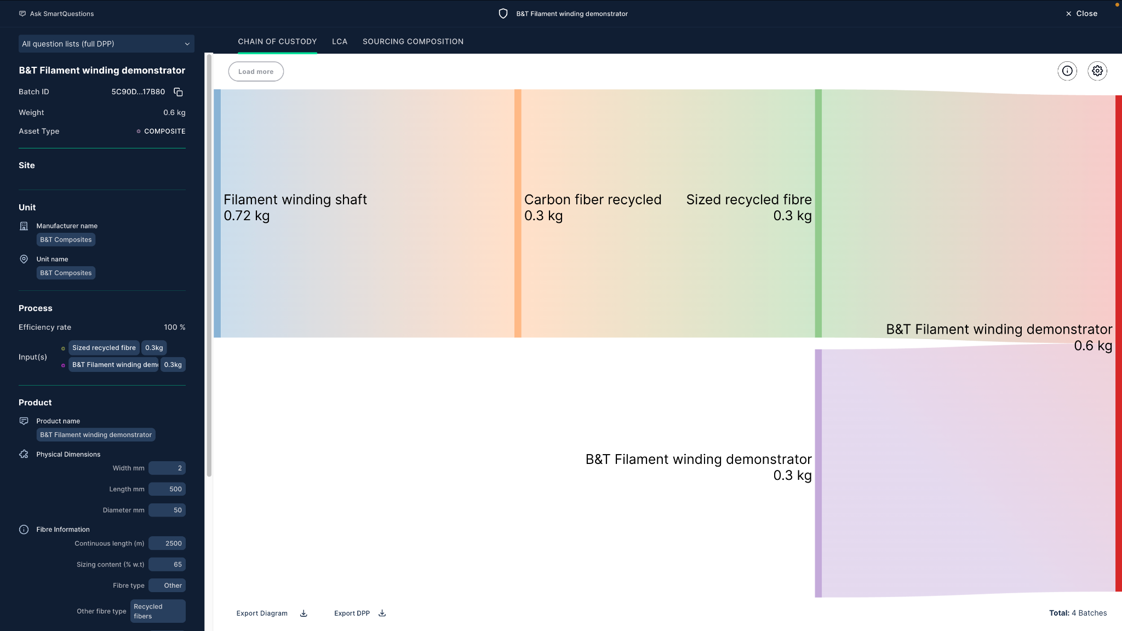
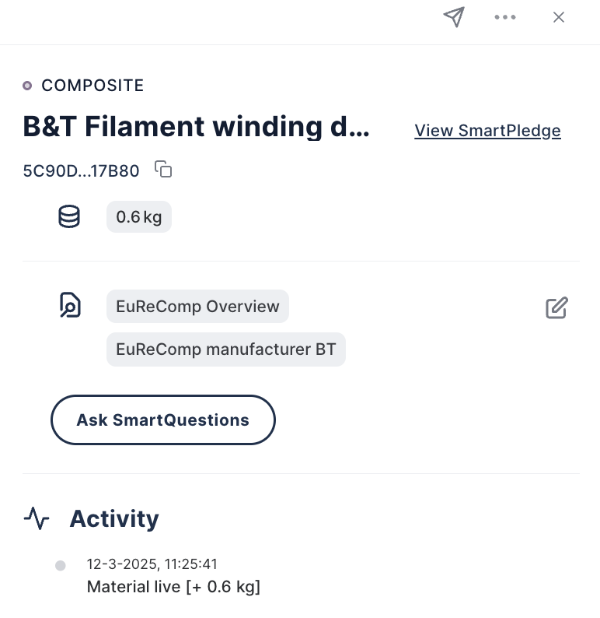
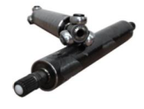

EuReComp – Remanufacture use case
Tubular shaft traceability
Tubular shaft from EoL automotive parts
Notes:
In EuReComp Circularise supported multiple pilots to demonstrate its technology. Here we can see how we were able to trace a tubular shaft produced by B&T Composites. In the Sankey diagram companies can click on the different components and they will be able to have access to the data shared by its owner.
Here for example, we can see some of the data from the final product, for example the dimensions and some fibre information.
As mentioned before, this information comes directly from each company in the value chain, providing reliable information. And they can determine who have access to each data point, protecting their sensitive data

Slide 14
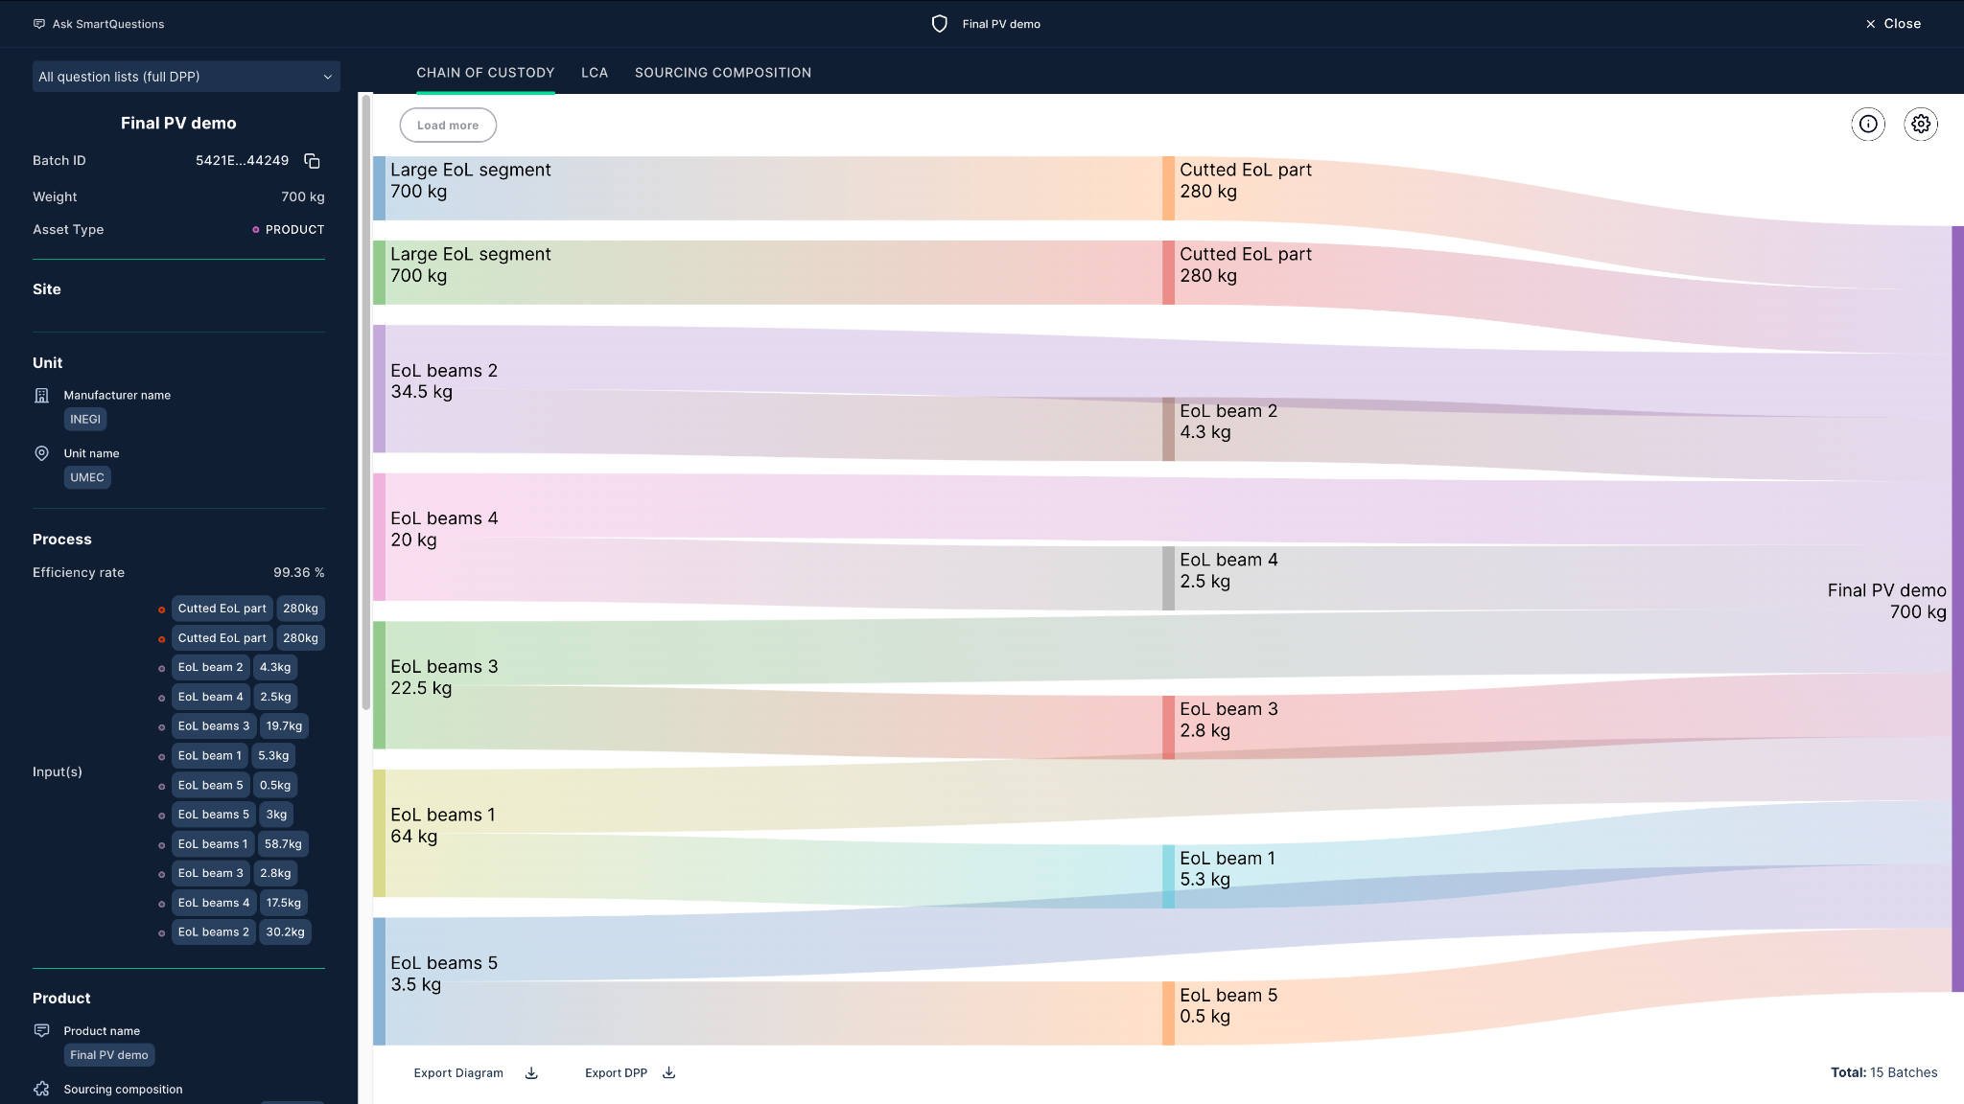
EuReComp – Reuse use case
PV panel traceability
PV panel from EoL wind turbines
Notes:
This is another example of the pilots from the eurecomp project, and it is a PV panel made of EoL wind turbines. You can see how even more complex value chains that involve multiple components and steps can be traced in the platform. Just as before, users will go through the components in the dashboard and access the details of each of them to have a better understanding of their value chains.

Slide 15
Roundtable discussion
Notes:
Now with this background, we can jump into the roundtable with the experts.

Slide 16
Questions
Notes:
Now we have some time for questions from the public

