Slide 1
Reuse and repurpose of end-of-life high
performance composite parts
4th Webinar-18th of Dec. 2024 (Teams)
Andreia Araújo – INEGI
Francisco Lahuerta – Itainnova

Slide 2
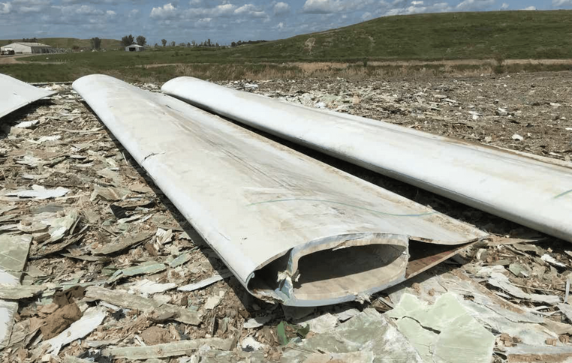
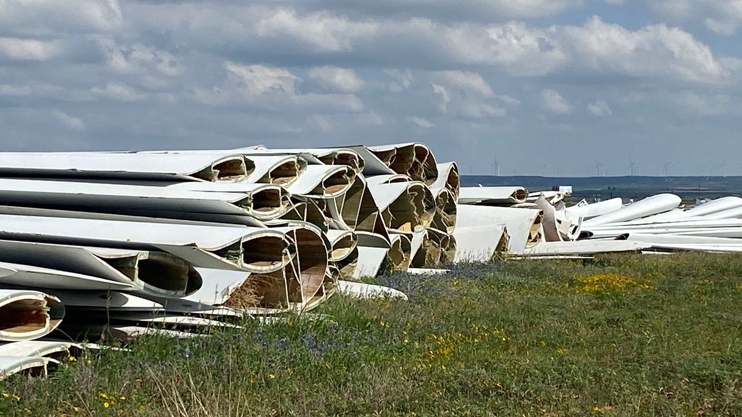
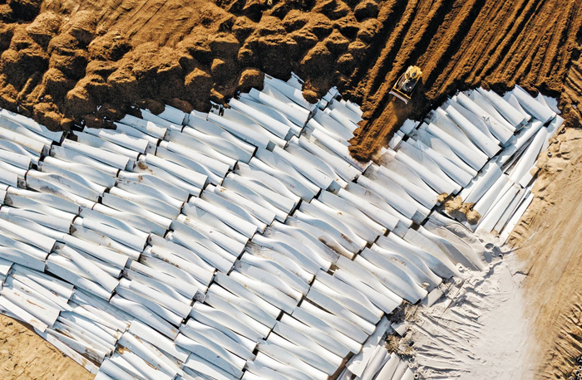

EoL WTB – Alternatives pathways
What to do when Life Extension is possible?
R1 | Reuse
Life
Extension
“Waste” reduction
R2 | Repair
R3 | Refurbish
R4 | Remanufacture
R5 | Repurpose
R6 | Recycling
High-added value products

Slide 3
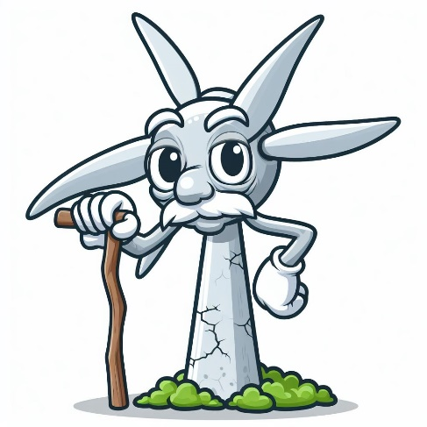

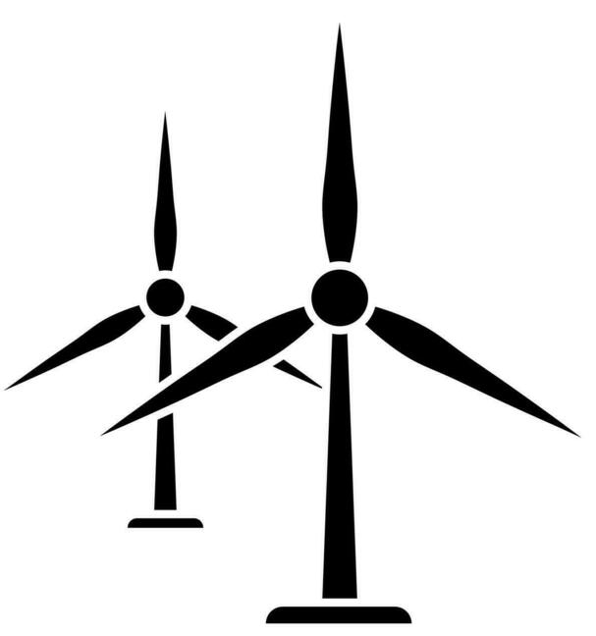
Lifetime extension and End-of-Life normative for WTB
Life span
20-25 years
WTs
+5 to +10 years
extension before
decommission
Life extension
Sectorial normative
Lifetime extension of wind turbines applies to all types of wind turbines and provides principles, technical requirements and guidance for the lifetime extension of both onshore and offshore. This extension is considered technically and economically when a wind turbine reaches its original design lifetime (20-25 years)
The sectorial normative which applies to wind turbines and in particular for WTB:
  DNVGL-ST-0262:2016 – Lifetime extension of wind turbines
  DNVGL-SE-0263:2016 – Certification of lifetime extension of wind turbines
  DIN SPEC 4866:2020 document that specifies the framework conditions for the sustainable and efficient dismantling, disassembly, recycling and recovery of onshore wind turbines
  WindEurope – Decommissioning of Onshore Wind Turbines (2020) is an Industry Guidance Document
  DIN IEC/TS 61400-28 (VDE V 0127-28) is a technical specification (TS) related to wind energy generation systems

Slide 4




Brief breakdown of the life-extension process
Data collection
Life extension assessment (Risk management)
Implementation
Site info
Historical data
Maintenance and
inspection reports
SCADA data
Site permissions
Condition monitoring data if available
Load modelling
Analyze RUL (remaining useful life) assesment
WTBs and structural components
End-of-life inspections
Assessing the current condition thorough inspections
Report & Certification
Documenting and certifying of findings and formulating life extension strategy
Apply strategy
Condition monitoring system
Fleet optimization
Maintenenance
Repairs
Continuous monitoring (data collection & regular inspections)

Slide 5
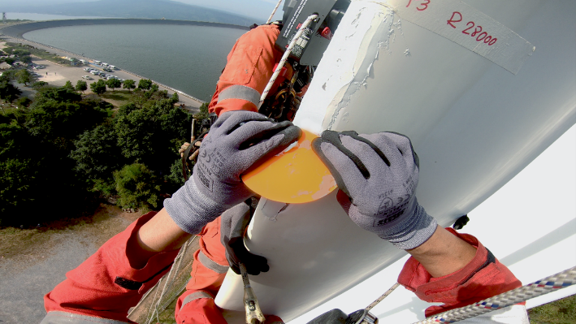
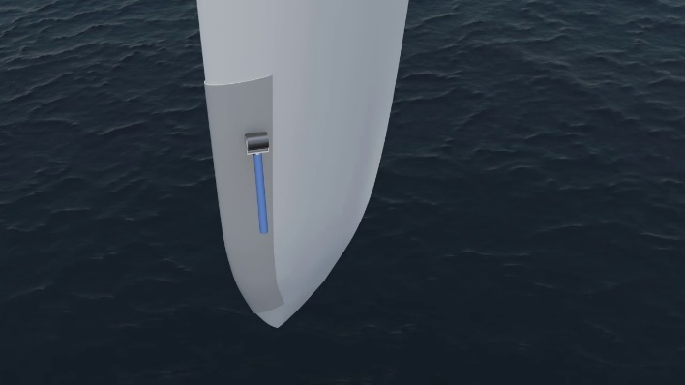
Repair techniques
Erosion repair and protection
Anti-erosion coating repair is usually the first and most recurrent repair performed in wind turbine blades.
  Risks: lead to crack progression through the laminates, water penetration into the material
Repair solutions for eroded blades include anti-erosion:
  Protective coatings of epoxy and polyurethane fillers.
  The application of filler is a highly labour intensive and
  usually not automate
  Protective coatings in the form of protection tapes from
  durable, abrasion-resistant polyurethane elastomers.
  The tapes, typically made of polyurethane,
  provides a ductile layer to dampen the initial impact of
  the raindrops.
  Shells or shields of either rigid or semi-flexible materials.
  Using either rigid or semi-flexible materials. Manufactured
  in controlled productions environments. Positioned straight
  onto the leading edge by means of adhesives
https://blog.belzona.com/new-leading-edge-repair-an-protection-solution
https://www.polytech.com/wtg-manufacturers/elle-leading-edge-protection

Slide 6
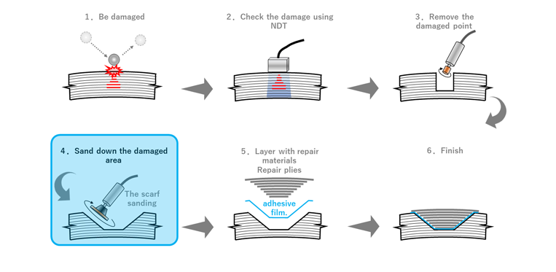
Repair techniques
Structural repair, patches and scarfs
The most suitable and used technique is flush repair. That is, forming a joint between the prepared area to be repaired and a repair patch. The procedure includes,
  the removal of the damaged region known as scarfing
  (conical or stepped) the preparation of a patch
  bonding between the patch and the host structure
  (pre-pregs, adhesive films or infusion)
  manufacturing technique of the patches:
    Soft patch: When the composite patch is co-cured
    Hard patch: When the patch is previously manufacture
    in an autoclave and then bonded (not very usual, require
    close tolerances between the patch and the part)
  in all cases the final surface does not match the finishing criteria and require of a re-work with fillers or coatings
doi: 10.1016/j.renene.2019.03.113 – Mishnaevsky 2019

Slide 7
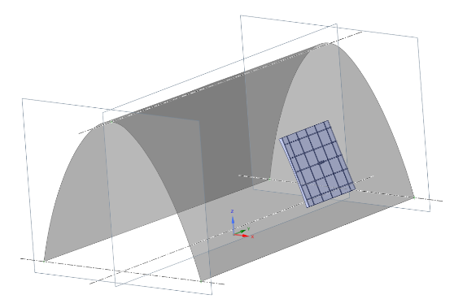
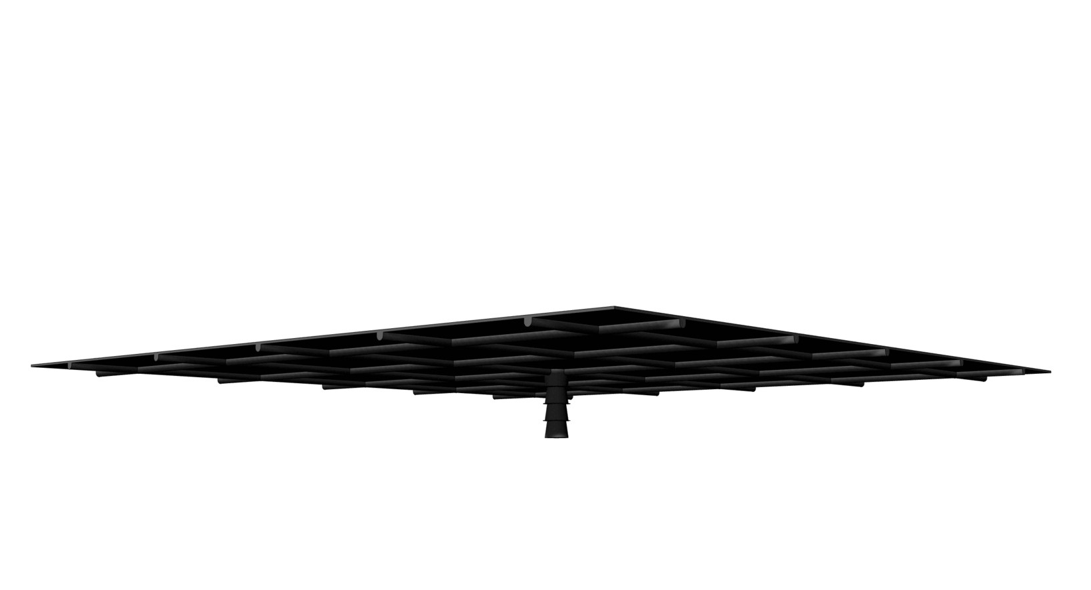
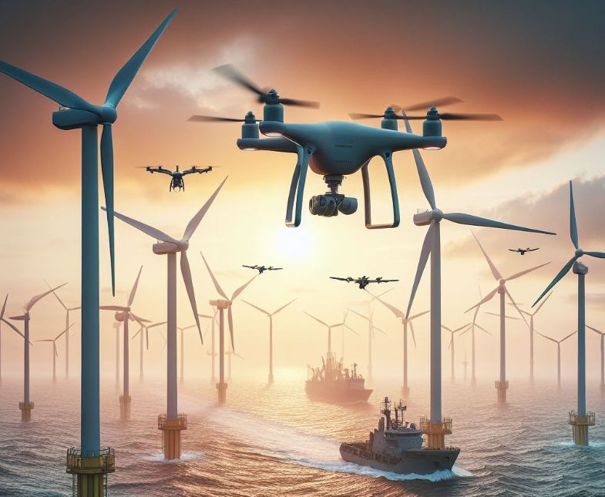
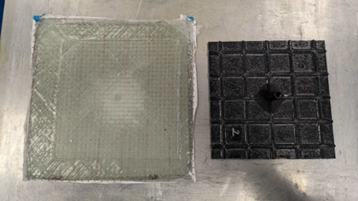
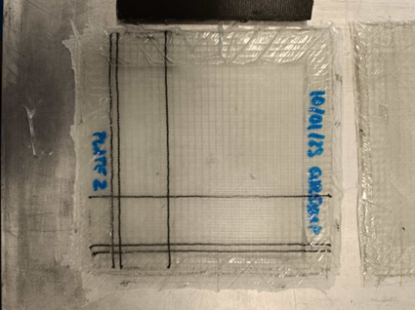
Repair techniques in EuReComp
Evaluation of surface and structural repair strategies
based on 3D AM printed caul plates tools
Evaluation of surface and structural repair strategies based on 3D AM printed caul plates tools
  Avoid secondary finishing processes like grinding and
  improve superficial tolerances
  3D printed tool shapes tailored to specific geometries
  (collaboration with BioG3D)
  Applicability to drones repair works
Demonstrator trials
Evaluation of finishing
Evaluation of processability

Slide 8
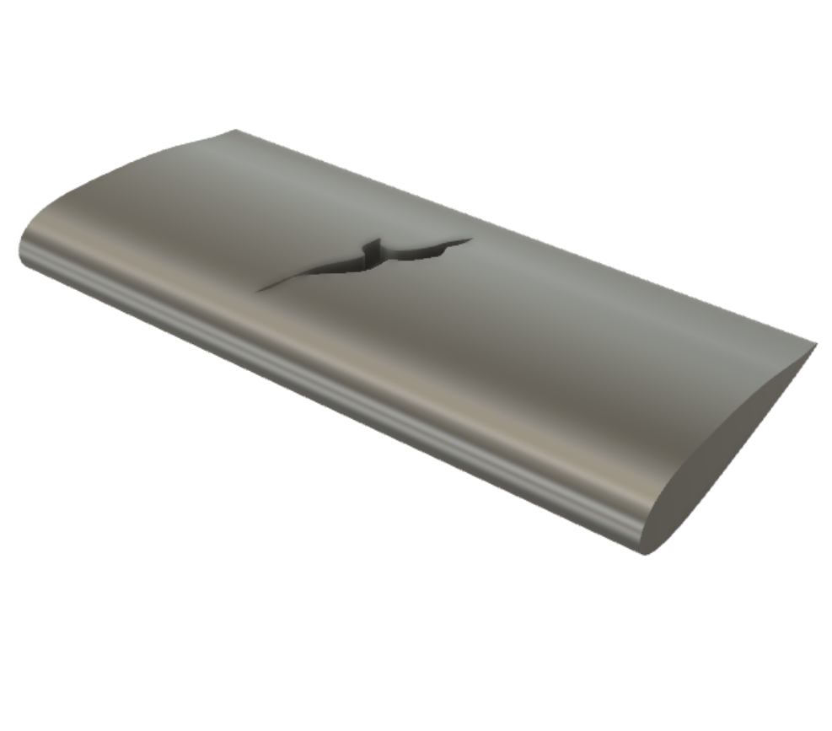

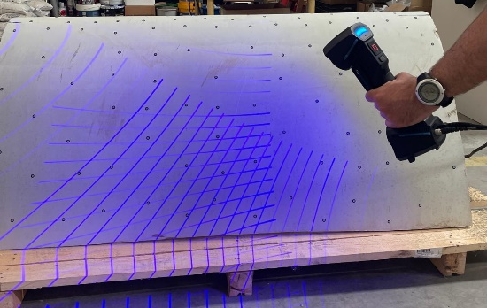
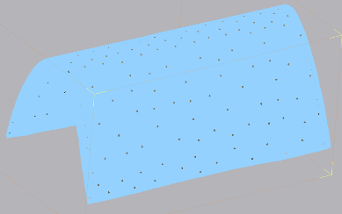
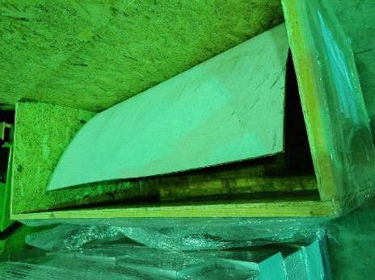
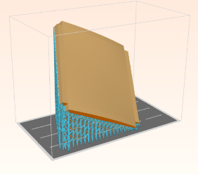
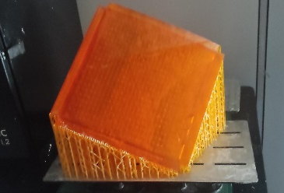
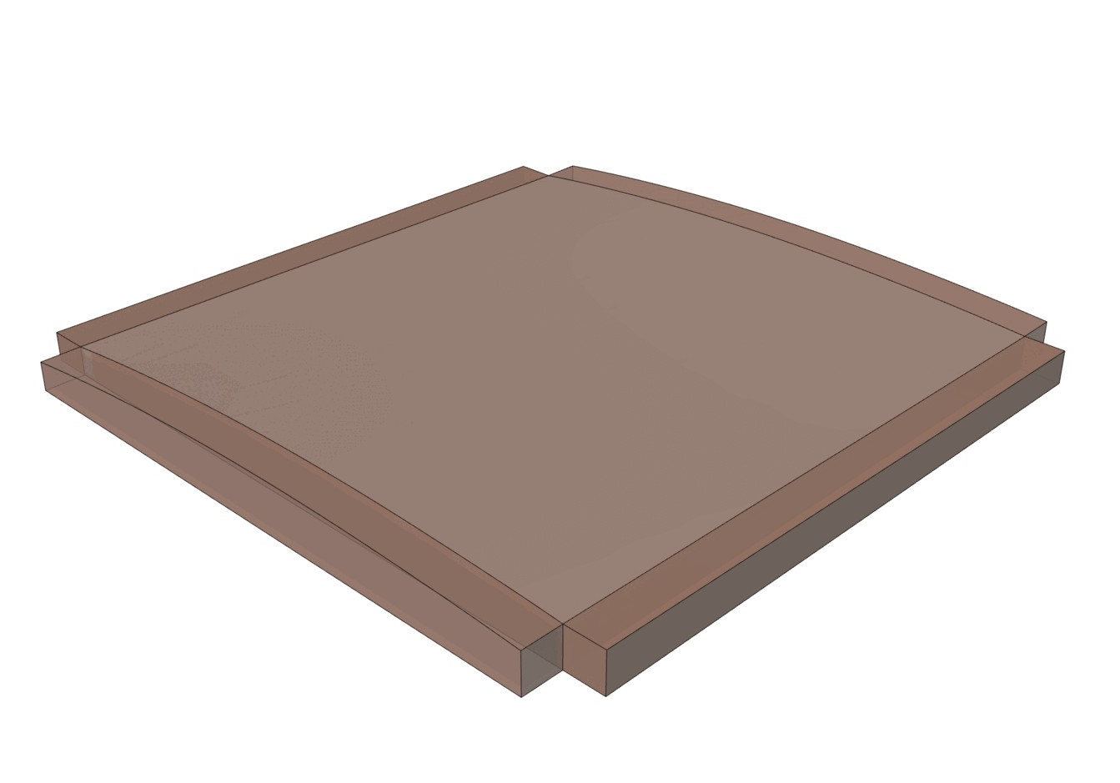
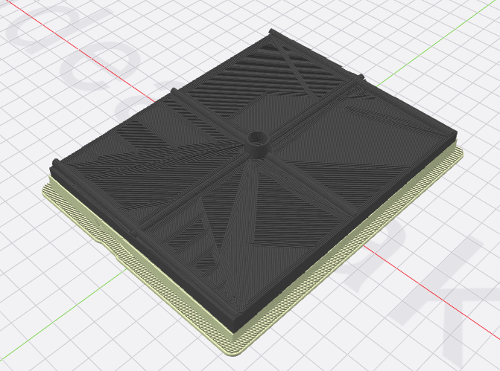
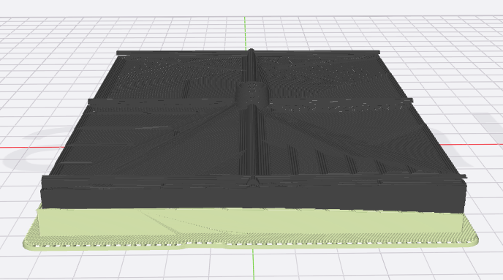
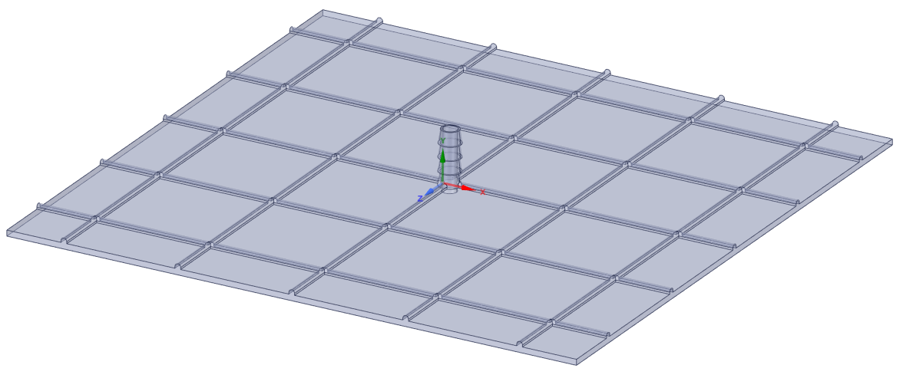
Repair techniques in EuReComp
Evaluation of surface and structural repair strategies
based on 3D AM printed caul plates tools
CAD model
3-D camera measurement blade curvature
CAD design of the caul-plate adapted to the curve surface
Identifications of damages and repairs suitable for this technique
- Bibliographic review on WTB damages and repairs
Demonstrator specifications
- 3D printing tool
- Materials definitions
- Repair process specification
3D-Printing (BioG3D)
Conformal 3D printing with FFF of the caul-plate
Patch repair with 3D printed
caul plate adapted
to the blade
wrapping. To be
develop
Demonstrator trials
- Evaluation of finishing
- Evaluation of processability

Slide 9
EoL WTB – Alternatives pathways
What to do when Life Extension is not possible?
R1 | Reuse
“Waste” reduction
R2 | Repair
R3 | Refurbish
R4 | Remanufacture
R5 | Repurpose
R5 | Repurpose
R6 | Recycling
High-added value products

Slide 10
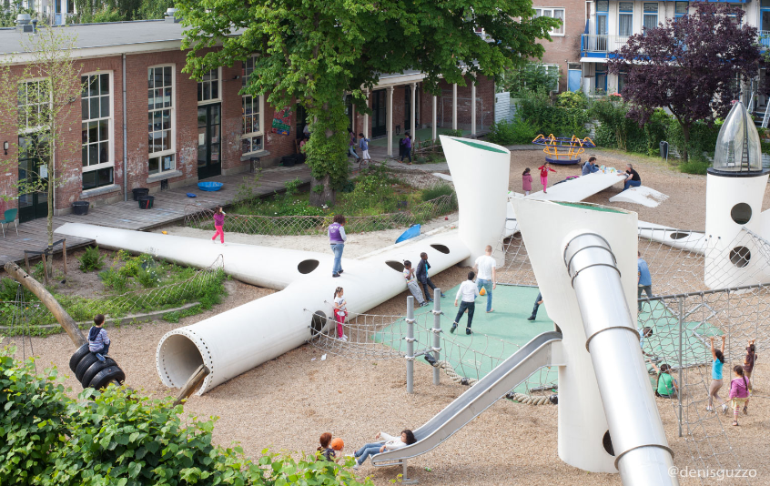
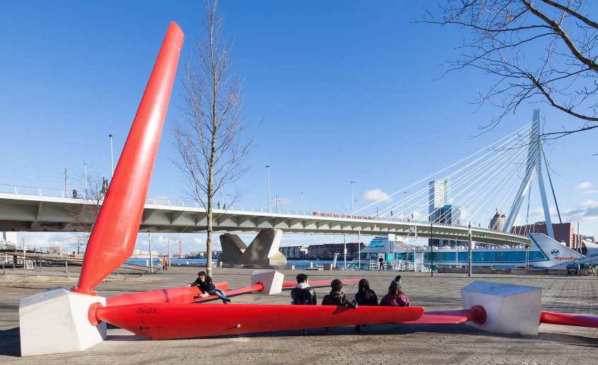
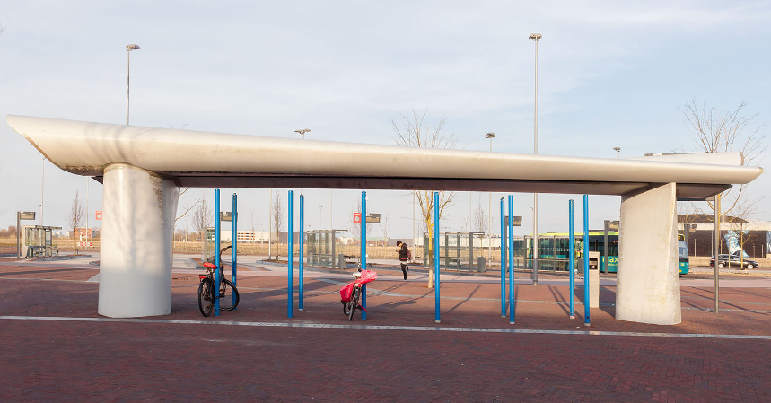
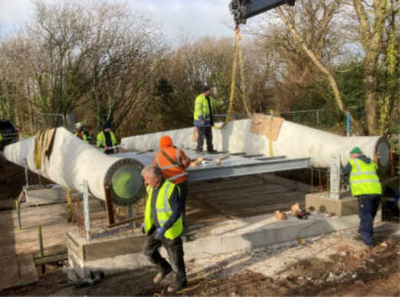
EoL WTB – Redesign for repurpose
Case Studies
https://www.re-use.eu/blade-made
https://www.re-use.eu/blade-made
https://www.re-use.eu/blade-made
Wikado one-off playground with a similar cost but a smaller ecological footprint using 5 of 30 m blades.
Willemsplein public seating: urban seating using 9 of 6 m WTBs was designed and installed in a Rotterdam square
REWIND ALMERE (Bus shelter): convert 30 m blades into pieces of the functional urban architecture
Pedestrian bridge: using 2 8.5 m WTBs as side girders that transfer the loads from a concrete deck to the supports
Zhang, Z., et al. BladeBridge - Design and Construction of a Pedestrian Bridge using Decommissioned Wind Turbine Blades. in ICSA 2022

Slide 11
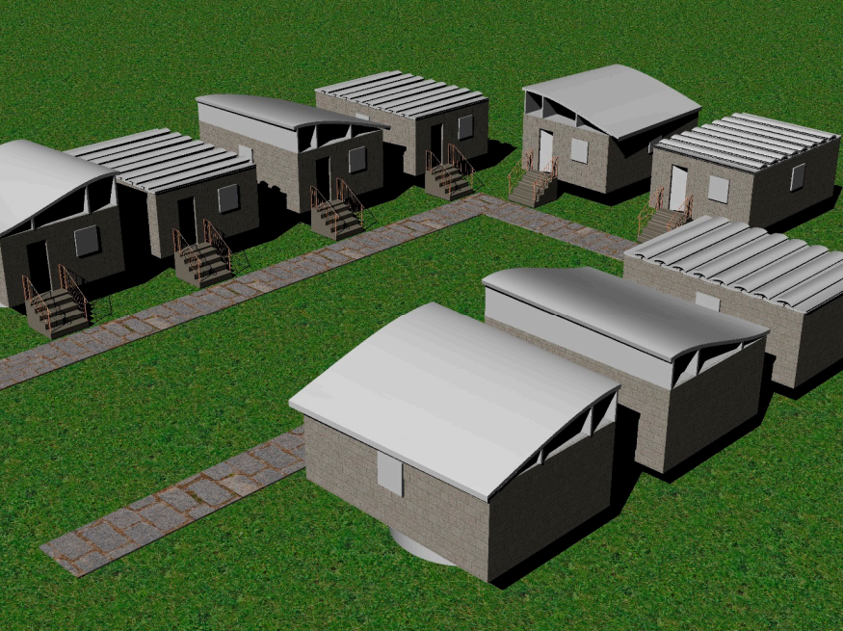
EoL WTB – Redesign for repurpose
Case Studies
Conceptual architectural housing for underdeveloped countries
using straight, slender panels, such as the blade’s shear webs as doors, window shutters, flood barriers, structural insulated panels and facades;
top and bottom airfoil sections as roof frames;
severely curved parts, such as the leading edge, as a concept for an interlocking shingle system for roofing as well;
the root section is also given functionality as an elevated foundation system in areas where flooding is bound to occur.
Bank, L.C., et al., Concepts for Reusing Composite Materials from Decommissioned Wind Turbine Blades in Affordable Housing. Recycling, 2018. 3(1): p. 3.

Slide 12
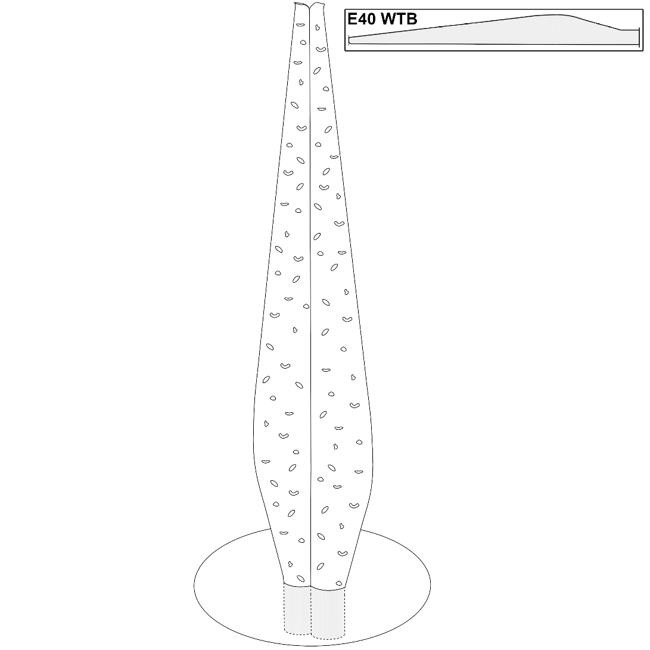
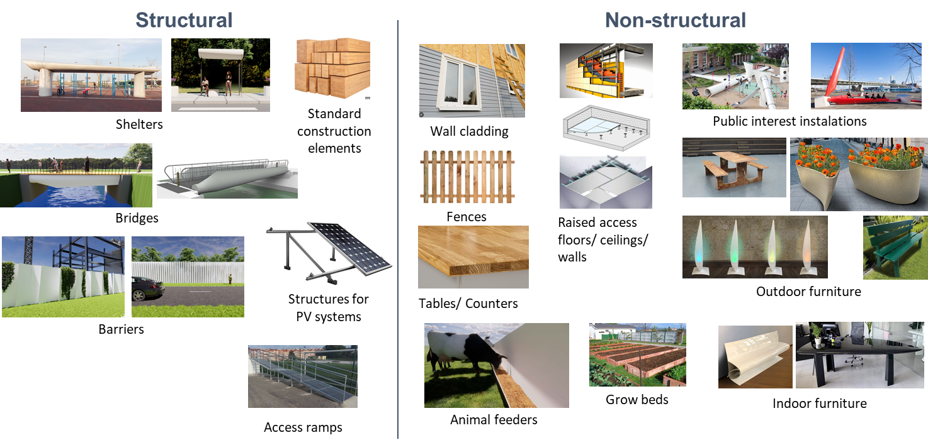
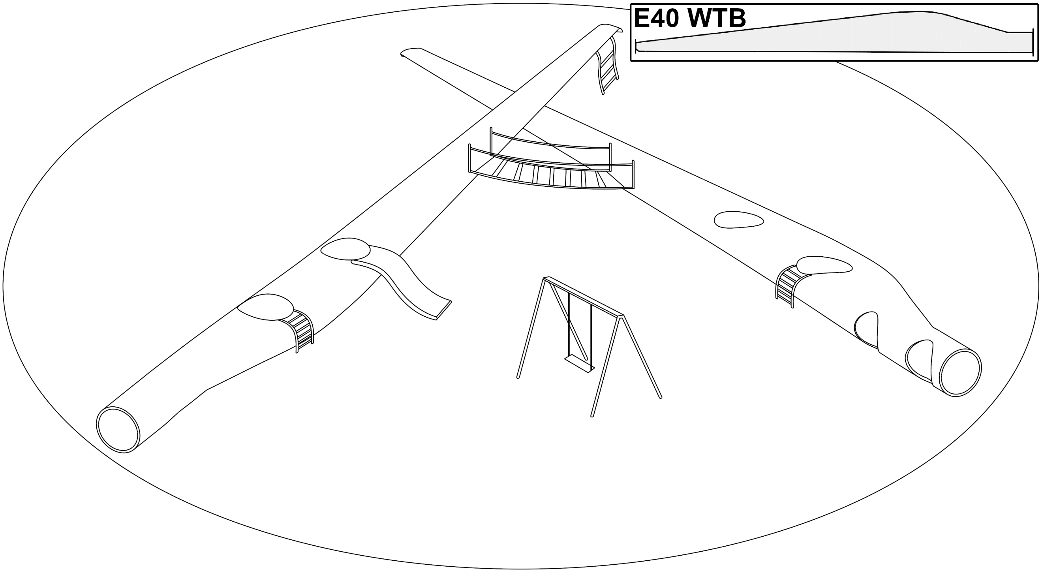
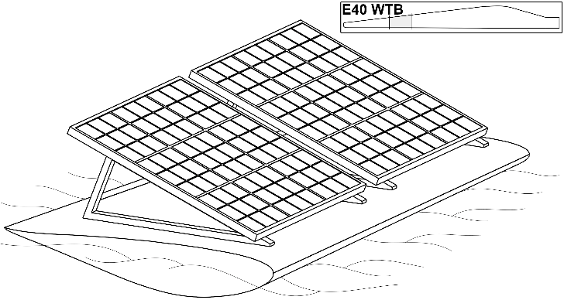
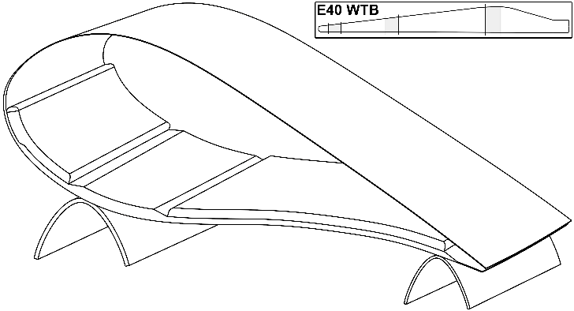
EoL WTB – Redesign for repurpose
Approaches
1- High-loaded complete structure
  e.g. a climbing tower from an EoL WTB
2 - Low-loaded complete structure
  e.g. a playground from an EoL WTB
3 - High-loaded segmented structure
  e.g. PV-floating system from an EoL WTB
4 - Low-loaded complete structure
  e.g. lounger/furniture from an EoL WTB

Slide 13
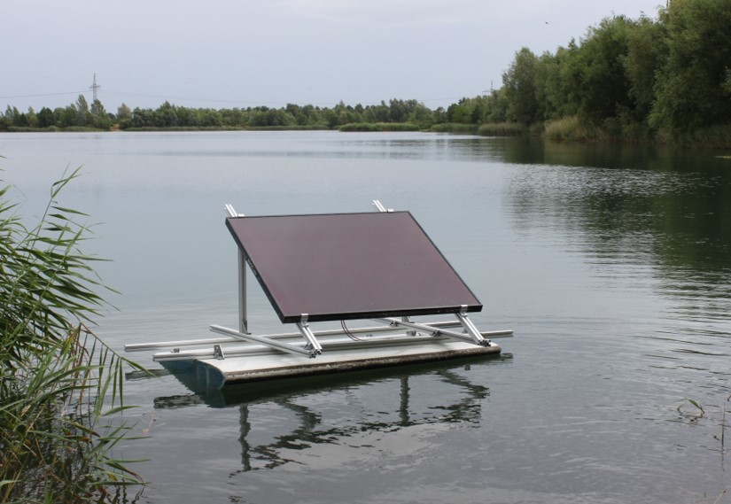
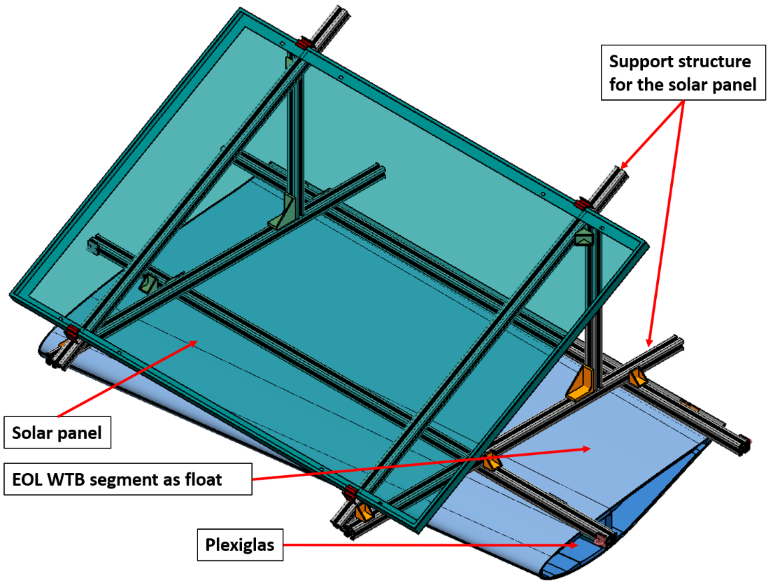


EoL WTB – Redesign for repurpose
Structural demo case: Floating PV structure
(1) Concept small-scale platform
Small-scale: for tests and to gain knowledge for the larger demo
Initial proof of concept.
Develop a methodology to close the ends.
Evaluate flotation capacity (closing of ends, sealing methodologies).
Test connections to the WTB.
Load application via spar cap.

Slide 14
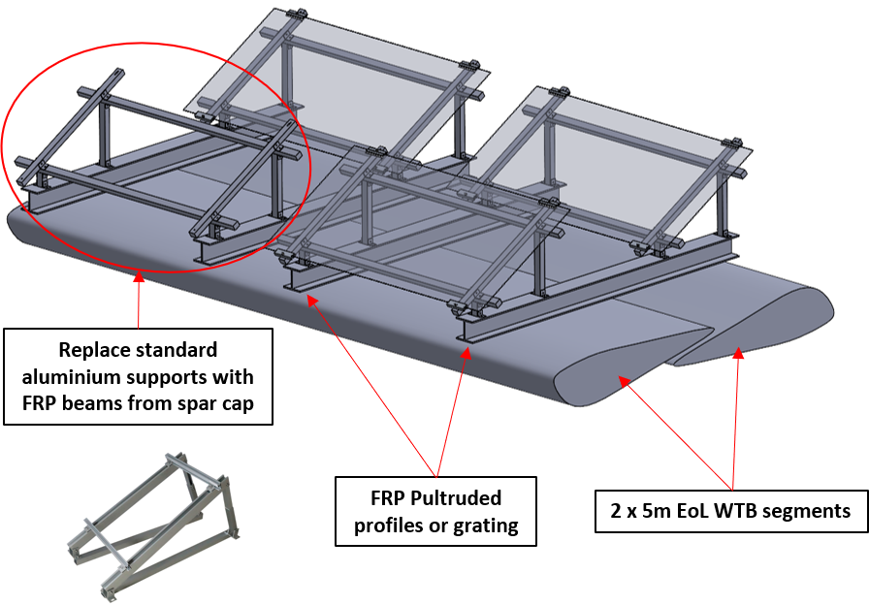
EoL WTB – Redesign for repurpose
Structural demo case: Floating PV structure
Large-scale: to implement constructive solutions in a larger scale

Slide 15
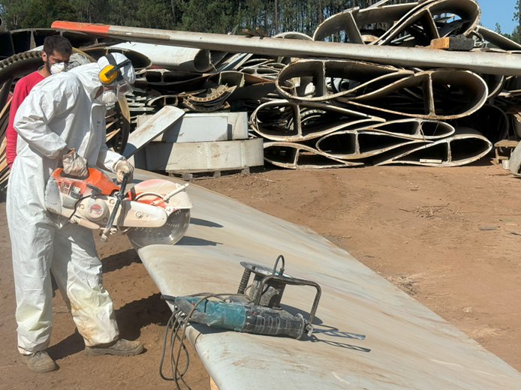
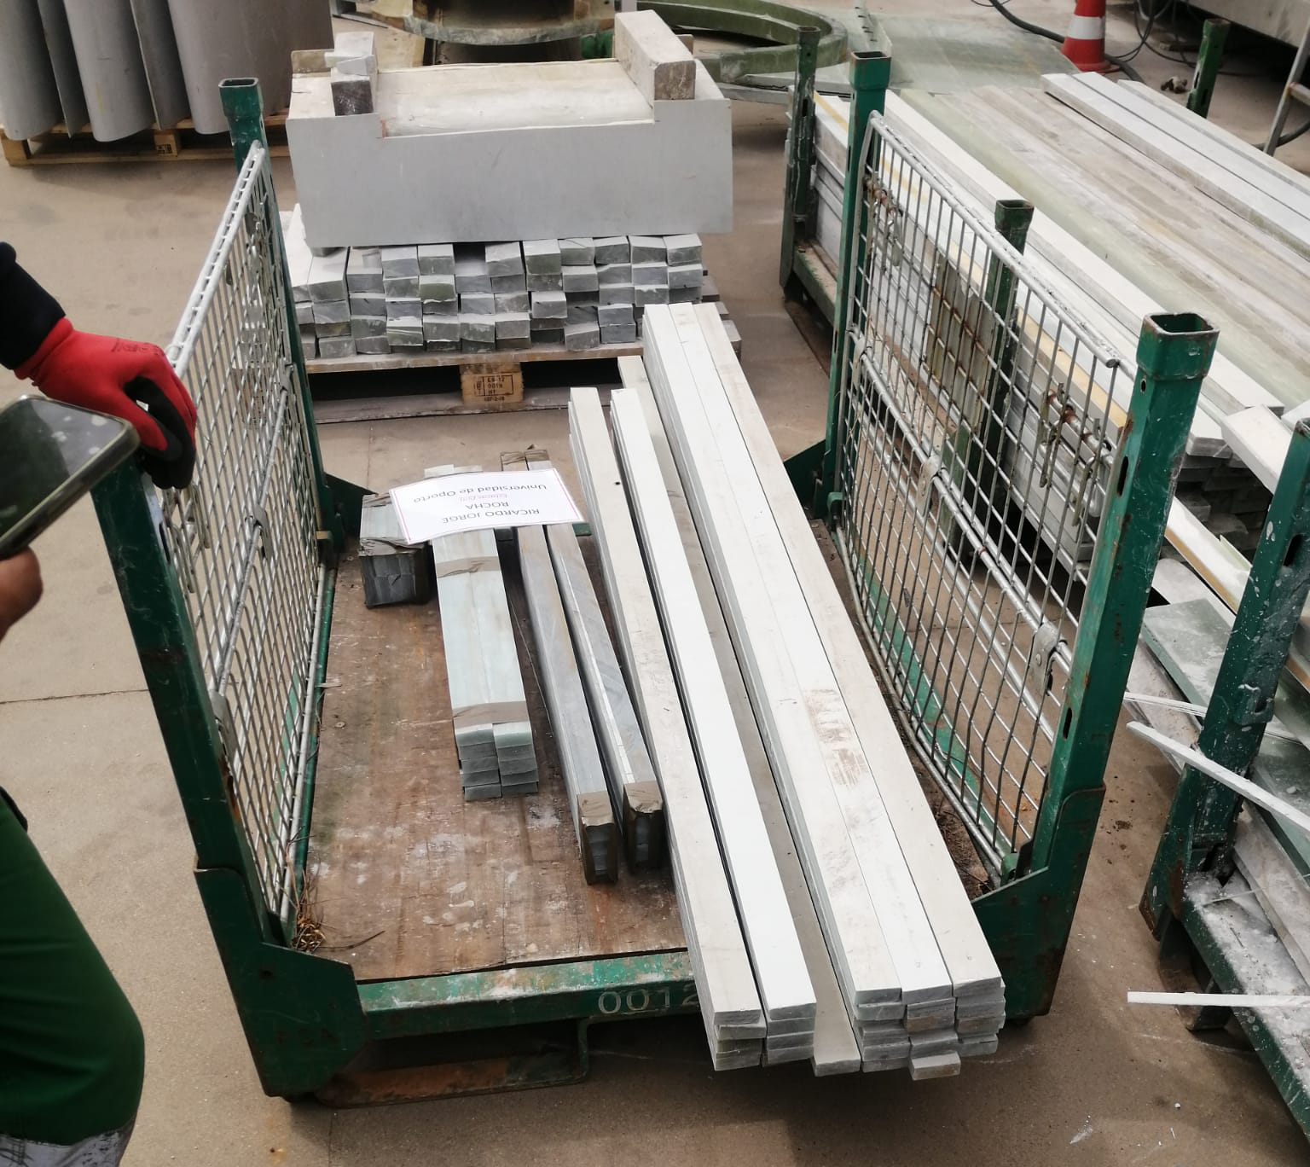
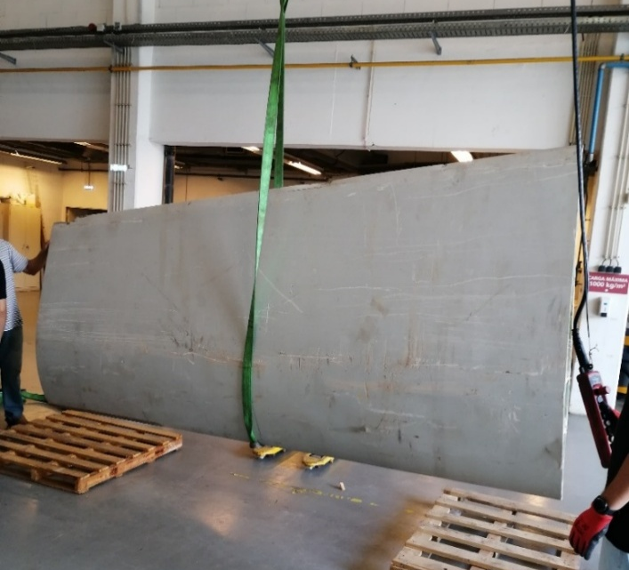
EoL WTB – Redesign for repurpose
Structural demo case: Floating PV structure
Cutting 10 m long WTB sections into the desired length
GFRP Beams cut from the spar cap to replace aluminium profiles
Centre of mass calculation by searching equilibrium when lifting with straps along two axis

Slide 16

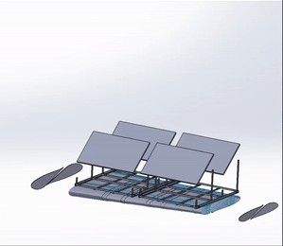
EoL WTB – Redesign for repurpose
Structural demo case: Floating PV structure
For more information and updates, follow the Eurecomp project website or social media!

Slide 17

Francisco Lahuerta – ITA
flahuerta@itainnova.es
Andreia Araújo – INEGI
aaraujo@inegi.up.pt

